Slide 1
CHEEREIO: a generalized, open-source ensemble-based chemical data assimilation and emissions inversion platform for the GEOS-Chem chemical transport model
10 November 2022 13th GEMS workshop
Drew Pendergrass
with Daniel Jacob, Hannah Nesser, Daniel Varon, Melissa Sulprizio, Kazuyuki Miyazaki, and Kevin W. Bowman

Slide 2
Table of contents
What CHEEREIO is and how it works
Example applications: CH₄ and NO_{x} inversions
Why CHEEREIO makes it easy to do inversions

Slide 3
Table of contents
What CHEEREIO is and how it works
Example applications: CH₄ and NO_{x} inversions
Why CHEEREIO makes it easy to do inversions

Slide 4
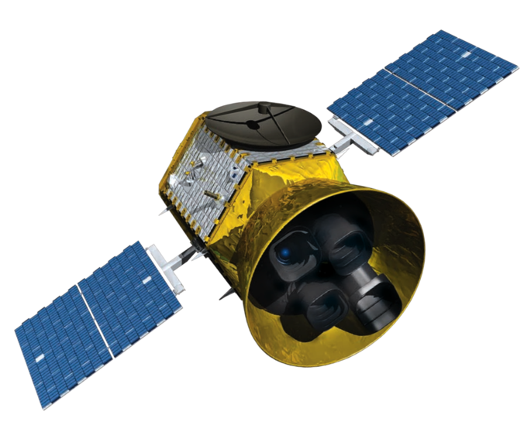
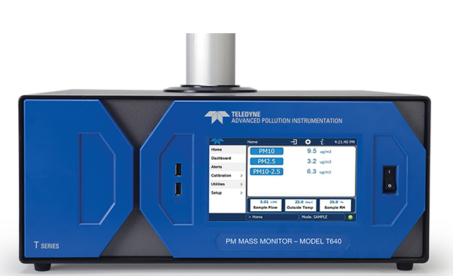
Data assimilation allows atmospheric models to incorporate observations
Assimilate
Remote sensing
Sunlight
Emissions and chemistry
corrected to match reality
Aerosols
and clouds
Transport
CHEMISTRY
Observe
Deposition
CHEEREIO
Anthropogenic and biogenic
emissions
Predict
Surface monitoring

Slide 5
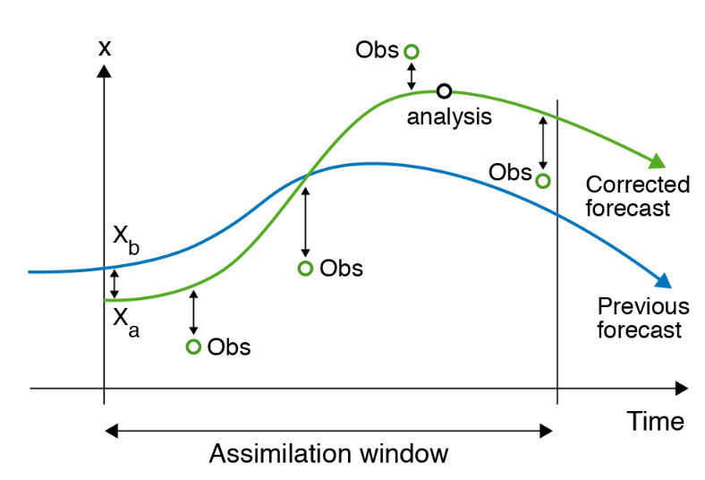
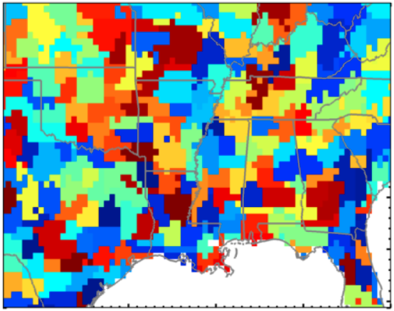
There are many approaches to assimilation and emissions correction
Variational approaches iteratively approximate optimal solution…
The analytical inversion perturbs
clusters of grid cells to obtain full error characterization…
ECMWF
Sheng et. al., 2018
…but 4D-Var requires adjoint; harder to work with most recent GC chemistry
…but requires hundreds of runs, and
works only for linear problems

Slide 6
CHEEREIO uses ensembles with random emissions to emulate model uncertainty
No data assimilation
With 4D-LETKF
Observations
Observations
Concentration
Concentration
Use observations to update emissions and concentrations over time
Base model
Base error
Ensemble of simulations
Time
Time

Slide 7
Summary of CHEEREIO project goals
Customization: Assimilate anything, in any GEOS-Chem configuration or simulation.
Maintainability: Science automatically aligned with latest model version
Powerful API: Minimal programming required for new simulations
Easy deployment: One configuration file controls installation and settings

Slide 8
Table of contents
What CHEEREIO is and how it works
Example applications: CH₄ and NO_{x} inversions
Why CHEEREIO makes it easy to do inversions

Slide 9
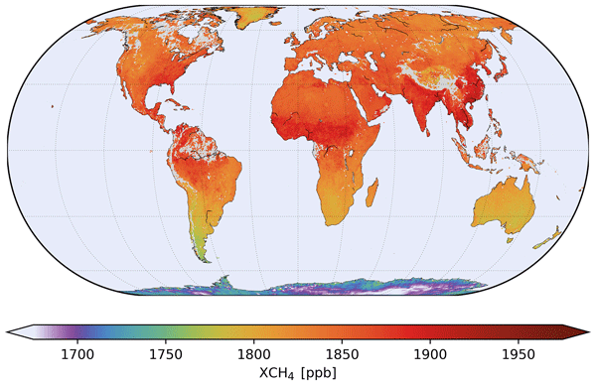
Applications currently under development
Optimize global NO_{x} emissions
Optimize global CH₄ emissions
Data on disk
Data on disk
HEMCO
HEMCO
Observations
Model state
Emissions
Observations
Model state
Emissions
OMI NO₂ columns
Species in NO_{x} mechanism
NO_{x} scaling factors
TROPOMI CH₄ columns
CH₄
CH₄ scaling factors
CHEEREIO
CHEEREIO
Simultaneously optimized NO_{x}
scaling factors and concentrations
Simultaneously optimized CH₄
scaling factors and concentrations

Slide 10
Evolution of CH₄ emissions scaling factors through assimilation
Assimilate every 7 days for one year (2019), with two months of burn-in assimilation discarded

Slide 11
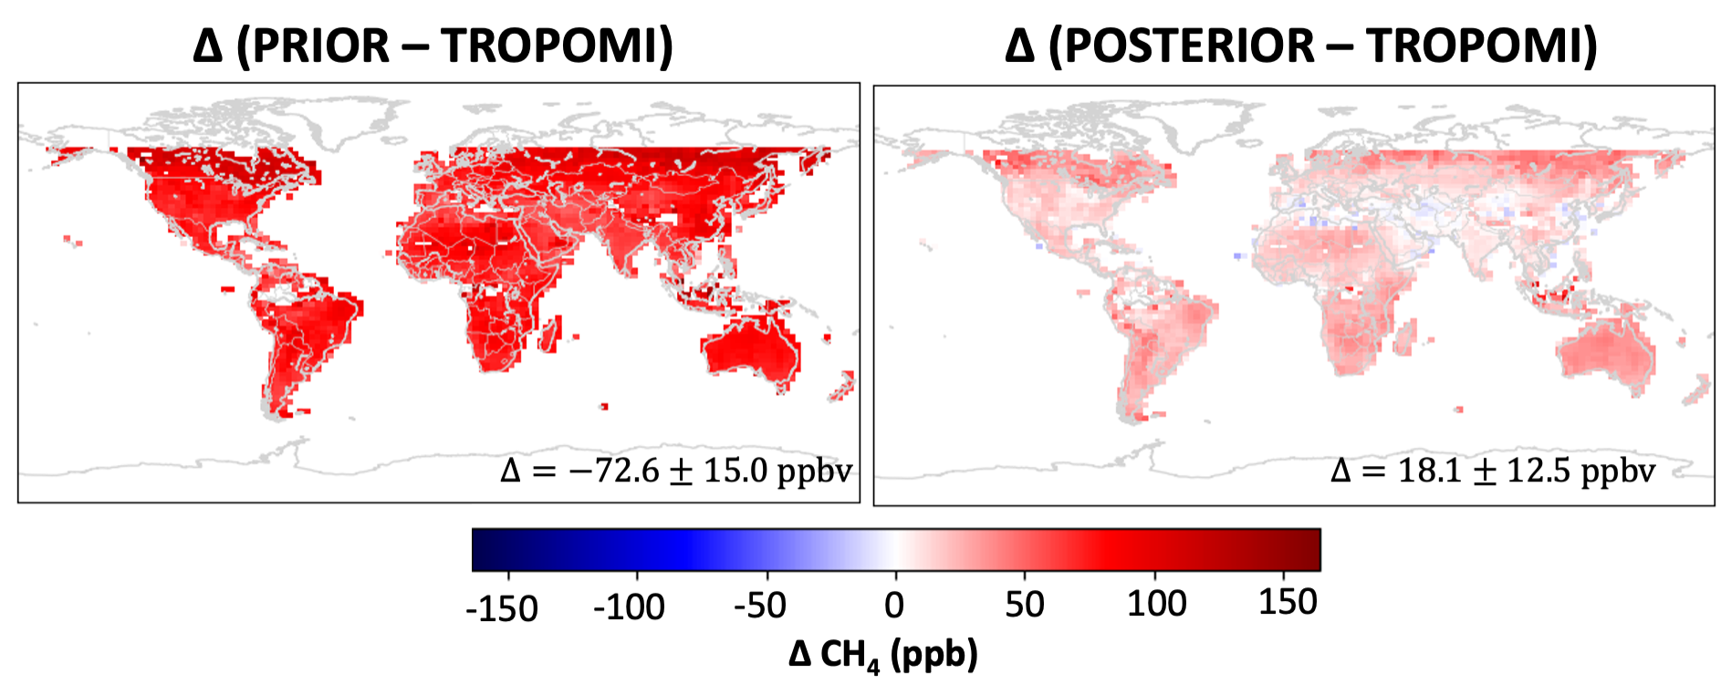
Assimilated results against observations, adjusted OH fields
-

Slide 12
Applications currently under development
Optimize global NO_{x} emissions
Optimize global CH₄ emissions
Data on disk
Data on disk
HEMCO
HEMCO
Observations
Model state
Emissions
Observations
Model state
Emissions
OMI NO₂ columns and
surface data
Species in NO_{x} mechanism
NO_{x} scaling factors
TROPOMI CH₄ columns
CH₄
CH₄ scaling factors
CHEEREIO
CHEEREIO
Simultaneously optimized NO_{x}
scaling factors and concentrations
Simultaneously optimized CH₄
scaling factors and concentrations

Slide 13
Evolution of NOx scaling factors through last two weeks of January 2016
Assimilate every 24 hours for two weeks (January 15-31, 2016)
Notes:
Had to average prior and posterior and limit scaling factor update to 50% to prevent scaling factors from jumping negative from a weird observation. Working to add more filters to protect against this.

Slide 14
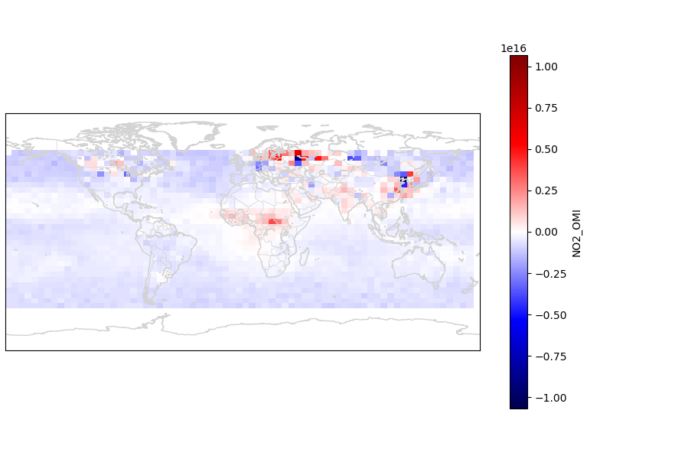
Comparison with prior
Δ (PRIOR – TROPOMI)
Δ (POSTERIOR – TROPOMI)

Slide 15
Table of contents
What CHEEREIO is and how it works
Example applications: CH₄ and NO_{x} inversions
Why CHEEREIO makes it easy to do inversions

Slide 16
Assemble the building blocks of your simulation in the configuration file
Combine the observations you want to use…
OMI
TROPOMI
GEMS
Select concentrations in your state vector…
From one file…
Surface obs.
Customize!
NO
NO₂
HNO₃
ens_config.json
…and customize filters and aggregation.
…and how they are defined.
Surface
Column sum
Tropospheric column
Define emissions in your state vector…
…and specify uncertainties.
NO_{x}
Transport NO_{x}
CHEEREIO puts the pieces together!
NO
NO₂
Industrial NO_{x}
Group emissions into families
Separate sectors for source attribution

Slide 17
Add new observation operators easily with Python-based inheritance
CHEEREIO is assembled from interchangeable blocks
CHEEREIO provides a template for observation operators…
Observation operators go here

Slide 18
Add new observation operators easily with Python-based inheritance
CHEEREIO is assembled from interchangeable blocks
CHEEREIO provides a template for observation operators…
OMI
TROPOMI
GEMS
Surface
Add your own!
…that then automatically plug in to the CHEEREIO workflow
GEMS inversion ready to go!

Slide 19
The CHEEREIO workflow
Emissions, boundary conditions, and meteorology on disk
ens_config.json
Observations on disk
Sample prior distribution of
scaling factors
Create template run directory
(User modifies as necessary)
Initial
conditions
N ensemble members
Wrap GEOS-Chem output, scaling factors, and observations in Python objects
Spinup run(s)
N ensemble members
Run GC until
assimilation
time
N ensemble members
GEOS-Chem/CHEEREIO model pipeline
Gather posterior concentrations and emissions
Simulate modeled observations (e.g. with averaging kernel)
Produce user-defined state vector containing relevant emissions and concentrations
Apply post-assimilation corrections
Run assimilation algorithm (LETKF)
No modifications of model code!!
CHEEREIO assimilation pipeline

Slide 20
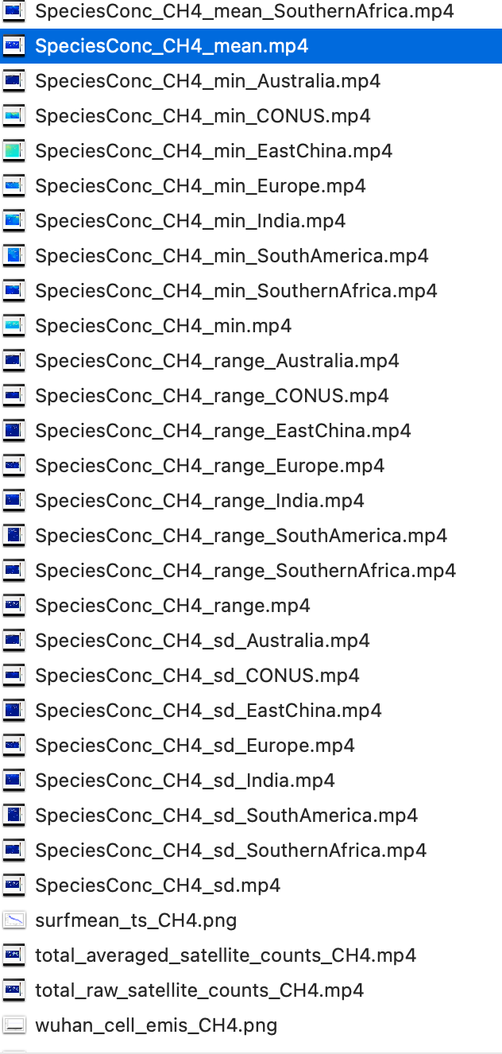
Postprocessing tools consolidate data and automatically produce hundreds of customizable animations and plots
All plots and movies shown previously were auto-generated by CHEEREIO!

Slide 21
CHEEREIO is documented on ReadTheDocs for ease-of-use, with lots of examples!
bit.ly/CheereioDocs

Slide 22
Why you should use CHEEREIO for GEMS
CHEEREIO makes it easy to do any inversion!
Combine GEMS with surface observations and other satellite instruments
OMI
TROPOMI
GEMS
Surface obs.
Customize!
Quickly run multiconstituent inversions with GEMS
Spend your time on science, not software engineering
NO₂
O₃
HCHO
Notes:
1) Cheereio almost ready! You should use it! It makes inversions as easy as they can be. I went from no NOx inversion, no operator, to running six different inversions in about a month.

Slide 23
Thank you! Questions?
Drew Pendergrass (pendergrass@g.harvard.edu)
Download and use* the code
Read the documentation
bit.ly/cheereio
bit.ly/CheereioDocs
*Official release and model description paper coming soon!

Slide 24
Extra slides

Slide 25
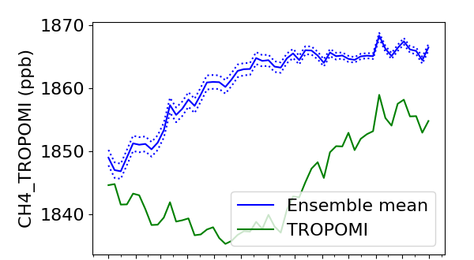
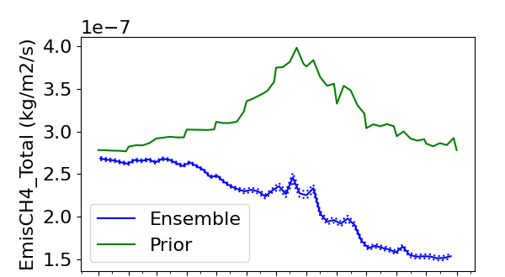
Current issues with the methane inversion
Jan
Mar
May
Jul
Sep
Nov
Jan
Mar
May
Jul
Sep
Nov
Month of 2019
Month of 2019
Prior error too small
Not enough burn-in time
Notes:
Xuan Wang’s Cl fields won’t run (causes crash). Further tuning of parameters necessary. Some sort of spread amplifier would be useful.
Want to deploy to cloud for NRT application soon.

