Slide 1
Data assimilation The science of error correction Drew Pendergrass Email your questions and corrections to Pendergrass@g.Harvard.edu
Uh oh! Looks like Homer’s prior was way off…

Slide 2
Table of contents
Overview of data assimilation
Some thoughts on chemical data assimilation (more throughout)
Overview of “standard methods”
3D-Var/4D-Var, including more details on GSI in GEOS-CF
Kalman filter
Link between Kalman filter and 3D-Var/4D-Var
Nonlinearities handled by Extended Kalman Filter (EKF)
Ensemble Kalman Filter (EnKF): Faster, better EKF
EnKF intuition
EnKF demo
Ensemble transform Kalman filter (ETKF)
EnKF for reanalysis or emissions updates offline: Ensemble Smoothing Kalman Filter (EnSF)
Summary
Localized ensemble transform Kalman Filter (LETKF)
Hybridizing 3D-Var and LETKF
Future of CDA

Slide 3
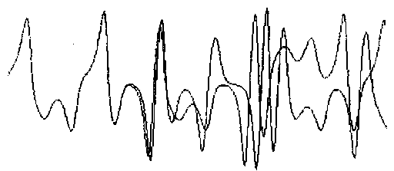
The origins of data assimilation
Data assimilation begins with meteorology, which is a chaotic, initial value problem.
Chaos: A slight change in initial conditions leads to wildly different outcomes: butterfly effect
Initial value problem: differential equations defined by initial condition
Lorenz model: classic chaos example
Tiny difference in
initial conditions

Slide 4
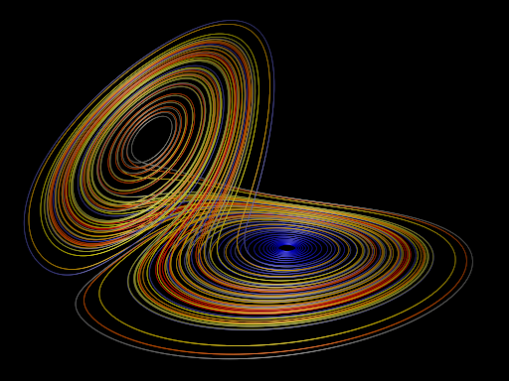
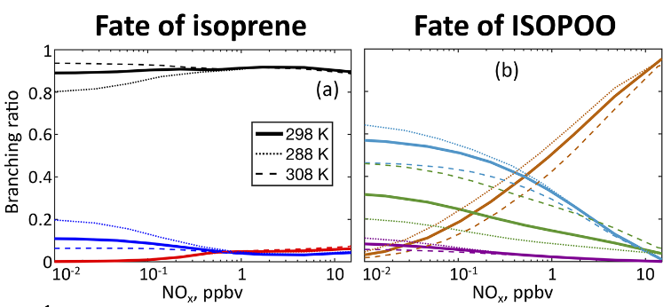
Principles of chemical data assimilation
Chemistry is distinct from meteorology for two key reasons:
It is not chaotic. Systems with moderately different initial conditions will tend towards similar equilibria.
The physical modelling problem is not solved. As such, we should consider model parameters like emissions to be a (variable) part of the system.
In meteorology, we ask “How do we update our initial conditions on the basis of the data?”
Meteorology is, roughly speaking, an initial value problem.
In chemistry we ask “How do we update the model itself on the basis of the data?”
Chemistry is, roughly speaking, a parameter estimation problem. Emissions matter more than concentrations, for example.
Lorentz attractor: classic meteorology
Kelvin’s paper: classic chemistry

Slide 5
Two methods, three main algorithms, and many combinations
Calculus of variations / optimal control
Statistical estimation
3D-Var
4D-Var
Ensemble Kalman filter (EnKF)
4D-EnVar
Gridpoint statistical interpolation (GSI) system
Integrated forecast system (IFS)
And other ‘hybrid’ approaches
Local ensemble transform Kalman filter (LETKF)
Particle filters
Used by GEOS, NOAA Hurricane WRF and Rapid Refresh, NCEP GFS, and many others. To be replaced by JEDI.
Used by ECMWF
Used by Miyazaki to update emissions
Can model
any PDF!
Notes:
Tease the big purpose of these algorithms.

Slide 6
3D-Var vs. 4D-Var: both minimize similar cost functions…
3D-Var
$$J\left(x\right)=\frac{1}{2}{\left(x−x^{b}\right)}^{T}B^{−1}\left(x−x^{b}\right)+\frac{1}{2}{\left(Hx−y\right)}^{T}R^{−1}\left(Hx−y\right)+J_{c}$$
Distance to model
Distance to observations
$x$ = analysis state vector
$x^{b}$ = background state vector
$B$ = background covariance
$H$ = “forward operator” that
maps model space to
observation space.
“$y_{i}$ = observation (at time i)
$R$ = observation covariance
$J_{c}$ = physical constraints
$M_{i}$ = forward operator at time i
4D-Var
$$J\left(x\right)=\frac{1}{2}{\left(x−x^{b}\right)}^{T}B^{−1}\left(x−x^{b}\right)+\sum_{i}{d_{i}^{T}R_{i}^{−1}d_{i}}+J_{c}$$
Distance to model
Distance to observations
Adjoint required
$$d_{i}=y_{i}−H_{i}M_{i}M_{i−1}…M_{2}M_{1}x$$
Apply model so that observations line up in time

Slide 7
GSI system: “3½D-Var” via “first guess at the appropriate time” method
Idea: use multiple background files and interpolate
Observations
4D-Var
Adjoint operator
Forecast
3½D-Var
Observations
interpolation
Background file
Analysis time
Background file

Slide 8
3D-Var looks awfully familiar…
3D-Var
$$J\left(x\right)=\frac{1}{2}{\left(x−x^{b}\right)}^{T}B^{−1}\left(x−x^{b}\right)+$$
$$\frac{1}{2}{\left(Hx−y\right)}^{T}R^{−1}\left(Hx−y\right)+J_{c}$$
Maasakkers et. al., 2019
Forward operator maps state vector
to methane column using GEOS-Chem

Slide 9
The analytic solution to 3D-Var is simple!
Set the gradient of the cost function equal to 0!
3D-Var
$$∇J\left(x\right)=B^{−1}\left(x−x^{b}\right)−H^{T}R^{−1}\left(y−Hx\right)$$
$$0=B^{−1}\left(x−x^{b}\right)−H^{T}R^{−1}\left(y−Hx\right)$$
$$B^{−1}\left(x−x^{b}\right)=H^{T}R^{−1}\left(y−Hx\right)$$
Some tedious matrix algebra…
$$x=x^{b}+{BH}^{T}{(R+H{BH}^{T})}^{−1}\left(y−Hx^{b}\right)$$
Unsurprisingly, this is the same solution as the analytic methane inversion!
In the methane case, $H$ transforms the state vector (methane emissions), which we want to optimize, into methane columns, which we observe. In that case, H is unusually expensive to calculate: it is the Jacobian of GEOS-Chem.
Note: this solution assumes linearity of H! Except in a few limited circumstances, this is not a reasonable assumption…

Slide 10
Although analytic solutions exist, in practice 3D-Var and 4D-Var are solved iteratively
3D-Var
Step 1
Step 3
Step 5
Make initial guess
Compute the gradient of the (linearized) cost function
Repeat inner and outer loops until convergence
(or, more realistically,
until max iterations reached)
$$x=x^{b}$$
$$∇J\left(x\right)=B^{−1}∆x−H^{T}R^{−1}\left(o−H∆x\right)$$
Step 2
where $∆x=x−x^{b}$
Step 4
Complete nonlinear forward operator $h.$ Compute Jacobian $H.$Compute $o=y−h(x^{b})$
Take a step in direction
of the gradient
Outer loop (nonlinearities)
Inner loop (linear optimization)
4D-Var
Iterative solver allows us to optimize general nonlinear systems (i.e., everything but methane)!
Same as 3D-Var, but with this gradient
$$∇J\left(x\right)=B^{−1}\left(x−x^{b}\right)−\sum_{k=0}^{K}{M_{1}^{T}M_{2}^{T}…M_{k}^{T}H_{k}^{T}R_{k}^{−1}\left(y_{k}−M_{k}…M_{2}M_{1}x\right)}$$

Slide 11
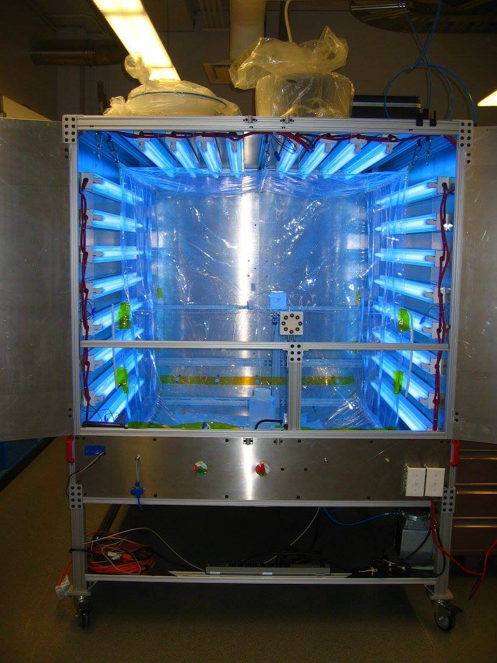
The background error is where the magic happens
We compute out background concentrations $x_{b}$ and
estimate our background covariance $B$ somehow, perhaps
by running KPP as a box model.
Imagine we are running a box model of a well-mixed chamber, but we observe only formaldehyde. Our goal is to infer concentrations of other species, particularly ozone.
The observation operator in this case is trivial:
$$H= \left[0,0,…, 0,1,0,…,0,0\right]$$
HCHO
Our instrument has a known error of 1 ppb,
so we have $R=1$ ppb.
Example adapted from Data Assimilation by Asch et. al., pg 59.

Slide 12
The background error is where the magic happens
Suppose we observe $y=12$ ppb HCHO.
Then the increment $x−x^{b}$ is
proportional to a column of $B.$
Setting the 3D-Var gradient equal to zero gives us
$$\left(x−x^{b}\right)=\frac{12 ppb −x_{HCHO}}{0.1 ppb}\left[\begin{matrix}B_{1,HCHO} \\ ⋮ \\ B_{n,HCHO}\end{matrix}\right]$$
$$\left(x−x^{b}\right)={BH}^{T}R^{−1}\left(y−Hx\right)$$
Here $Hx=x_{HCHO}$, or the HCHO concentrations after
assimilation.
${BH}^{T}$ will just be a column of $B$ reflecting
HCHO’s covariance with other species in the model.
$R^{−1}=0.1$ in this scalar case.
Vector
Scalar
Vector
Absolutely critical idea: background covariance matrix provides the link between the parts of the system that we observe and the parts of the system that we cannot see.
A good estimate of $B$ is the perhaps the most important part of data assimilation. Think of it as a kind of linearization of the system.
Example adapted from Data Assimilation by Asch et. al., pg 59.

Slide 13
GSI 3D-Var background matrix computation
From here, in GSI, we compute regression coefficient between stream function and (1) velocity potential, (2) temperature, and (3) surface pressure. These coefficients help build up unbalanced fields from which length scales are computed, layered Gaussian filters are applied to create anisotropy and heterogeneity, and B is constructed.
I am skeptical this will work very well for chemical data assimilation. The 48 hr and 24 hr chemistry forecasts valid at same time should be essentially identical because chemistry is deterministic. This isn’t a good way of estimating the inherent variability of a non-chaotic system! In fact, GEOS does have an existing ad hoc method for estimating ozone background error independent of meteorological variables: horizontally invariant, it is set at 4% of global mean ozone at each level with some prescribed length scales [GEOS 5 manual]. That isn’t good enough for proper CDA.
Previous generation 3D-Var system, the Spectral Statistical Interpolation (SSI) system, applied background update in a spectral space where the background matrix B was diagonal. But this led to an issue: once we transform back to physical space, our errors are forced to be geographically homogeneous and isotropic [Wu et. al., 2002].
The current Gridpoint Statistical Interpolation (GSI) system is in physical space. Estimate is based on National Meteorological Center (NMC) method:
$$B≈\frac{1}{2}\left\langle \left(x^{48h}−x^{24h}\right){\left(x^{48h}−x^{24h}\right)}^{T}\right\rangle$$
$x^{48h}$ and $x^{24h}$ are lagged forecast pairs (24 and 48 hr forecasts valid at same time) sampled through a long period of time. Stream function and velocity potential must be calculated using a Poisson eqn. solver [2018 NOAA DA Training at CIRA]

Slide 14
Including emissions in GOES-CF, first thoughts
A good estimate of $B$ is the perhaps the most important part of data assimilation. GSI is highly tuned to weather phenomena, but many of the assumptions (chaos, ad hoc methods of computing covariances for each variable) fail in the deterministic, high-dimensional world of chemistry.
We also might be able to exploit the deterministic nature of chemistry to reduce computational requirements. In meteorological data assimilation much of the “information content” from estimations of $B$ go into controlling the Lyapunov exponents, or degree of chaos of the system [Trevisan and Palatella, 2011]. Intuitively, at least, we don’t have to worry about controlling chaos and could use the information elsewhere, or reduce computations.
I’ll go into more details later, but there is a way to combine Miyazaki’s ensemble method for linking emissions with concentrations empirically, using a Monte Carlo approach, with the existing GSI code. This is a part of a cutting edge new field in DA, emerging in the past 10 years: hybrid methods.
But first: we need to introduce these ensemble methods.

Slide 15
Kalman Filter: a natural way to preserve error information and sensitivities over time.
No data assimilation
Kalman filter
Observations
Concentration
Base model
Updates with every observation,
not at after a fixed period of time
as in 3D-Var and 4D-Var.
Base error
Idea: we accumulate information about the system over time by iteratively updating the state and error, unlike the variational methods which minimize a cost function “in one go” over a fixed time period.

Slide 16
Kalman filter algorithm
Step 0: Initialize
Step 1: Forecast
Step 2: Assimilation
Set initial conditions $x_{0}^{a}$,
and covariance matrix $P_{0}^{a}$
$${x_{k+1}^{f}=M}_{k+1}x_{k}^{a}$$
If observation not available, continue forecasting.
If observation exists, assimilate it!
$${P_{k+1}^{f}=M}_{k+1}P_{k}^{a}M_{k+1}^{T}+Q_{k+1}$$
Calculate “Kalman gain”:
$$K_{k+1}=P_{k+1}^{f}H^{T}{(HP_{k+1}^{f}H^{T}+R_{k+1})}^{−1}$$
Model error covariance
Update the state vector:
$$x_{k+1}^{a}=x_{k+1}^{f}+K_{k+1}(y_{k+1}−Hx_{k+1}^{f})$$
Model linearization
Kalman gain is derived using Bayesian statistics on Gaussian distributions, and is the ideal fusion of observations and model data on the basis of their respective errors.
In the basic algorithm, we assume a linear model $M$ and observation matrix $H$.
Update the covariance matrix:
$$P_{k+1}^{a}=(I−K_{k+1}H)P_{k+1}^{f}$$
A note on data assimilation terminology:
Superscript “f” means forecast. Out of the model.
Superscript “a” means analysis. Output of Kalman filtering.
Subscript denotes the timestep.
For notational consistency, I put an “a” on the initial conditions

Slide 17
Link between Kalman filter and variational methods
Kalman filter is most general of the methods we have
discussed so far and includes error characterization.
The Kalman gain looks awfully familiar…
Assume linearity and Gaussian error:
get Kalman filter
Recall the 3D-Var/methane inversion analytical solution:
$$x=x^{b}+{BH}^{T}{(R+H{BH}^{T})}^{−1}\left(y−Hx^{b}\right)$$
Call this $K.$
Assume perfect model:
get 4D-Var
Now look at the Kalman gain from the previous slide:
$$K_{k+1}=P_{k+1}^{f}H^{T}{(R_{k+1}+HP_{k+1}^{f}H^{T})}^{−1}$$
They are identical! The intuition is that this gain matrix weights observations and modeled fields in a way that minimizes error.
However, Kalman filter naturally assimilates at appropriate time
(like 4D-Var) and updates errors (unlike variational methods). That said, calculations on these error matrices at operational weather centers are intractable (usually order 10⁶ x 10⁶)
Assume stationary
model: get 3D-Var

Slide 18
Going nonlinear: the Extended Kalman Filter (EKF)
The extended Kalman filter:
By adopting the inner/outer loop structure, we were able
to extend 3D-Var and 4D-Var to the nonlinear case.
Can we do the same for the Kalman filter?
Step 0: Initialize
Set initial conditions $x_{0}^{a}$,
and covariance matrix $P_{0}^{a}$
Yes, but this is a terrible algorithm for three reasons:
Memory cost: requires manipulation of $\frac{n\left(n+1\right)}{2}$ scalars in error covariance matrix, where $n>{10}^{6}$ in online systems.
Computational cost: requires $2n$ runs of the tangent linear model to assimilate.
Coding cost: requires a tangent linear model, which is equivalent to building the adjoint.
Step 1: Forecast
$${x_{k+1}^{f}=𝔐}_{k+1}x_{k}^{a}$$
$${P_{k+1}^{f}=M}_{k+1}P_{k}^{a}M_{k+1}^{T}+Q_{k+1}$$
Here $M_{k+1}$ is the Tangent Linear Model (similar to adjoint)
and $𝔐_{k+1}$ is the full nonlinear model.
Step 2: Assimilation
Calculate “Kalman gain”:
$$K_{k+1}=P_{k+1}^{f}H_{k+1}^{T}{(H_{k+1}P_{k+1}^{f}H_{k+1}^{T}+R_{k+1})}^{−1}$$
Update the covariance matrix:
$$P_{k+1}^{a}=(I−K_{k+1}H_{k+1})P_{k+1}^{f}$$
Update the state vector:
$$x_{k+1}^{a}=x_{k+1}^{f}+K_{k+1}(y_{k+1}−ℌ_{k+1}x_{k+1}^{f})$$
$H_{k+1}$ =Tangent Linear Model
$ℌ_{k+1}$ = nonlinear observation model.
Notes:
Reduced rank methods can reduce this memory cost dramatically by storing only the most important modes, but the TLM is still required.

Slide 19
Ensemble Kalman Filter (EnKF): a powerful approximation to the EKF
Idea: instead of updating a giant covariance matrix containing error information, instead use an ensemble of full model simulations that reflect our uncertainty. This is a Monte Carlo approach of forming B!
Initialize an ensemble randomly, with state vector elements sampled from an appropriate PDF.
For chemistry, this might mean sampling concentrations and emissions from a lognormal.
We perturb everything randomly, unlike the formation of the Jacobian where we perturb one element at a time. This allows us to construct the analysis with far fewer model runs, but with some error introduced (not to mention rank degeneracy) because not all directions of variability will be covered.
Usually the number of ensemble members is far less than the number of elements. 32 is a standard number.
Evolve each ensemble member in parallel until observation time. At observation time, we emulate the Kalman filter assimilation process without explicitly forming the covariance matrices.
We can think of the ensemble members as approximating a “reduced rank” version of the background covariance matrix.
Observations
Concentration
Ensemble of simulations (like full GEOS-Chem runs)
Time

Slide 20
The EnKF algorithm
Step 0: Initialize
Step 1: Forecast
Continue evolving in time
until an observation arrives
Begin assimilation
Obtain $m$ state vectors $x_{i,0}^{a}$.
$${x_{i,k+1}^{f}=𝔐}_{k+1}x_{i,k}^{a}$$
Step 4: Compute normalized anomalies
Step 3: Compute ensemble means
Step 2: Draw observation ensemble
$$X_{i,k}^{f}=\frac{x_{i,k}^{f}−{\overline{x}}_{k}^{f}}{\sqrt{m−1}}$$
$${\overline{x}}_{k}^{f}=\frac{1}{m}\sum_{i=1}^{m}{x_{i,k}^{f}}$$
Simulates observation covariance matrix $R_{k}$
If we observe $y_{k}$, then draw $m$ observations
$y_{i,k}=y_{k}+u_{i}$ for $u_{i}\sim 𝒩(0,R_{k})$
$$Y_{i,k}^{f}=\frac{{ℌ_{k}(x}_{i,k}^{f})−u_{i}−{\overline{y}}_{k}^{f}+\overline{u}}{\sqrt{m−1}}$$
$${\overline{y}}_{k}^{f}=\frac{1}{m}\sum_{i=1}^{m}{{ℌ_{k}(x}_{i,k}^{f})}$$
$$\overline{u}=\frac{1}{m}\sum_{i=1}^{m}{u_{i}}$$
These anomalies function as the
“dominant modes” of the error covariance matrices, to use Hannah’s language! Captures the deviance of each ensemble member from the mean. Form these into matrices $X_{k}^{f},Y_{k}^{f}$
Step 5: Compute gain
Step 6: Update ensemble
Return to step 1
$$K_{k}=X_{k}^{f}{{(Y}_{k}^{f})}^{T}{\left[Y_{k}^{f}{{(Y}_{k}^{f})}^{T}\right]}^{−1}$$
$$x_{i,k}^{a}=x_{i,k}^{f}+K_{k}(y_{i,k}−ℌ_{k}x_{i,k}^{f})$$
This is the trick! We don’t have to invert our rank deficient ensemble matrix!

Slide 21
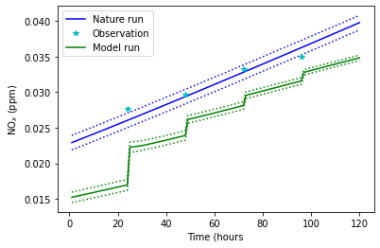
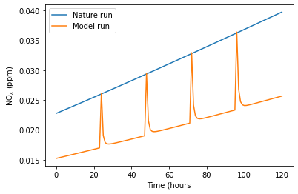
Simple EnKF demo
Parameters: SAPRC99 mechanism at high noon. Emissions for 29 species prescribed. 5 days of spinup. 32 ensemble members
Imagine that NO and NO₂ emissions in real life are 50% greater than the model. We take observations every 24 hours. How can we improve accuracy of our model?
Slope still wrong because
emissions not updated
Less naïve method: create an ensemble by varying initial
conditions and use EnKF to assimilate concentrations only
Naïve method: overwrite NO_{x} with measured values.
Chemical mechanism immediately pushes to previous equilibrium.
Emissions are still incorrect (see slope), but all species update to reasonable regime because background error propagates information to entire system.

Slide 22
An imaginary EnKF scenario explained in detail
Observations arrive! It’s 100 satellite NO₂ columns over the US. First, we must simulate the observations in each of our GEOS-Chem runs to compare them with the observations. This is done via the H operator. In this case, H might mean we integrate the columns of each model run and apply the satellite averaging kernel.
Run GEOS-Chem 32 times in parallel. In each instance, start with a randomly perturbed emissions field! For example, we might randomly choose scaling factors between 0.25 and 1.75 for every gridcell in the model. These could be independent (white noise) or reflect some prior knowledge of error covariance.
x 32
Run full models in parallel until an observation arrives
The normalized observation anomalies $Y_{k}^{f}$ are merely the difference between each simulated column and the mean ${\overline{y}}_{k}^{f}$. For example, if ensemble member 23 had higher NO₂ emissions over New York City, we might expect it to have a positive anomaly. There are other terms in this calculation that cleverly account for observation covariance. The details are not terribly important but are given on slide 30 if you’re curious.
Now we can begin calculating the normalized observation anomalies $Y_{k}^{f}$. We calculate this by first calculating the mean ${\overline{y}}_{k}^{f}$of each of the 100 columns across the 32 model runs. Now we have 100 “average columns” – our best guess of reality.
Continue to next slide.
Note: Miyazaki does something clever to parallelize the update step! I will explain this later.

Slide 23
An imaginary EnKF scenario explained in detail (continued)
Now that we have the normalized observation anomalies $Y_{k}^{f}$, we can calculate the normalized ensemble anomalies $X_{k}^{f}$. While the $Y_{k}^{f}$ term specifically measures the variance across ensemble members with respect to the simulated observations, $X_{k}^{f}$ measures the variance across the ensemble with respect to the entire state vector. In our case, this means the variance across all 32 GEOS-Chem model runs of species and emissions in every gridcell. There are ways to shrink this state space, such as by reducing the species considered, or by using Miyazaki’s localization method, or by updating only emissions. More on this later. In general, though, the state vector is huge.
The normalized ensemble anomalies $X_{k}^{f}$ are the difference between each element in the state vector and the mean ${\overline{x}}_{k}^{f}$. For example, since ensemble member 23 had higher NO₂ emissions over New York City, the surface NO₂ concentrations will likely be higher than the model average. Think of $X_{k}^{f}$ as capturing the natural variability in model state caused by randomly varying emissions.
Compute the gain: $K_{k}=X_{k}^{f}{{(Y}_{k}^{f})}^{T}{\left[Y_{k}^{f}{{(Y}_{k}^{f})}^{T}\right]}^{−1}$. Note we only invert in the (much reduced) observation space, which is guaranteed under all realistic circumstances to be full rank.
As before, we first calculate the mean ${\overline{x}}_{k}^{f}$of the 32 ensemble members’ states. It’s a full 3D representation of the ”average” model, or a reduced version of this as in Miyazaki’s work.
Finally, we update the ensemble using the gain to interpolate between model states and the observed columns. For example, if we observe high values in the NO₂ column over NYC, we will update concentrations in all 32 models accordingly and likely increase emissions in New York. (Continued).

Slide 24
More on the ensemble update step
When we perform the ensemble update $x_{i,k}^{a}=x_{i,k}^{f}+K_{k}(y_{i,k}−ℌ_{k}x_{i,k}^{f})$, what we do is change the entire state of the 32 GEOS-Chem simulations. This means overwriting potentially all concentrations in the 3D field and changing all emissions factors. In practice, we operate on a smaller subspace that prevents us from updating every little thing, but this is how it works in principle. Each ensemble member is updated slightly differently, so the variance across the 32 GEOS-Chem simulations is maintained.
In our scenario, a high NO₂ column measured over New York City with relatively high certainty will result in increasing NO₂ and related emissions in gridcells to which NYC is sensitive (New York and perhaps some cells to the west). The ensemble members with already high NO₂ values will increase slightly, while ensemble members with lower NO₂ values will increase more dramatically. We might begin to settle around the “correct” emissions scaling factor for NYC after a few weeks of observations.
If we want to calculate the error covariance matrix update, like in the Kalman filter (optional because the ensemble encodes this information), then there is a formula, identical to the previous Kalman filter update: $P_{k}^{a}=(I−K_{k}H)P_{k}^{f}$. Not computing this quantity is an easy way to gain computational efficiency, especially in the operational weather forecasting scenario.

Slide 25
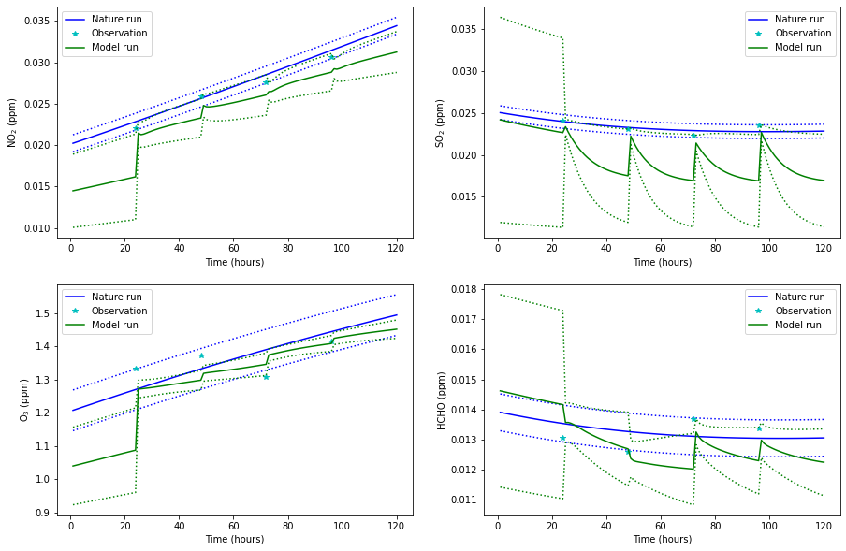
A “realistic” experiment:
Natural emissions are randomized within 50% of some base values via scaling factors. These emissions are unknown to the modelers.
We observe NO₂, SO₂, O₃, and formaldehyde every 24 hours.
At right is what happens when we update all 74 concentrations only using EnKF. Notice how the variation across the 32 ensemble members (green, dotted) reduces after an observation.
Blue dotted line represents observational uncertainty
Terrible!
NO₂
SO₂
Not so bad!
Green dotted line represents standard deviation across 32 ensemble members
Green solid line represents ensemble average across 32 ensemble members
O₃
HCHO

Slide 26
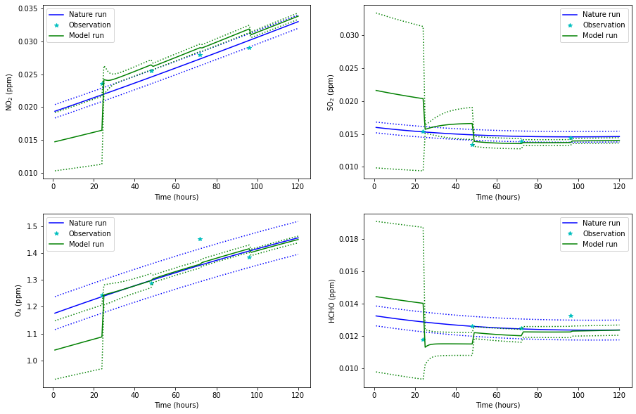
Much better! We learn
the correct emissions after just two observations!
NO₂
SO₂
At right is what happens when we update all 74 concentrations and all 29 emissions using EnKF.
O₃
HCHO

Slide 27
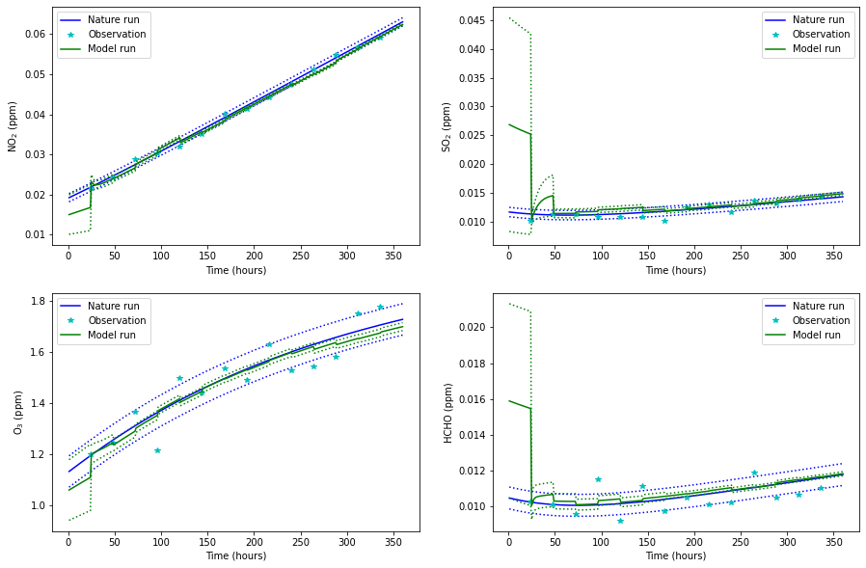
As before, but for a longer simulation.
What is happening here? The Kalman gain is constructed from the ensemble members as explained in previous slides, and includes links between every concentration and every emission in our box model. When we observe low SO2 values, for example, as in the first observation at left, we update relevant concentrations and emissions across all 32 ensemble members.
NO₂
SO₂
O₃
HCHO

Slide 28
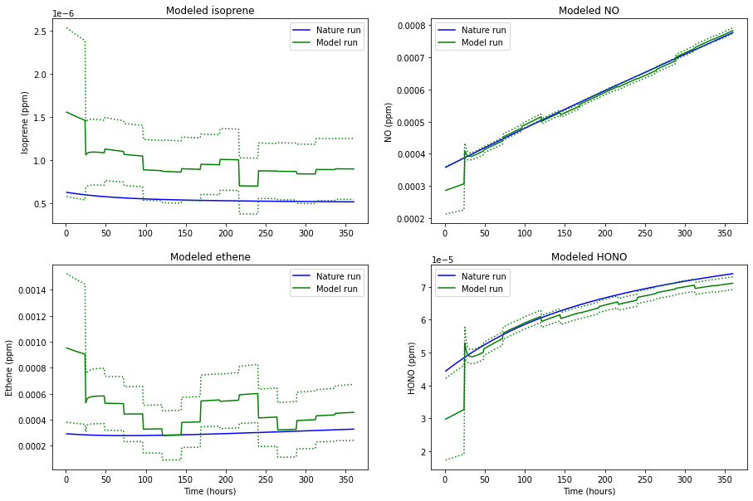
Unobserved species look good too, albeit with higher uncertainty, because they are linked within the system to the observed variables.
Recall that the background error covariance B (here approximated by the ensemble anomalies) links observations to the rest of the model!

Slide 29
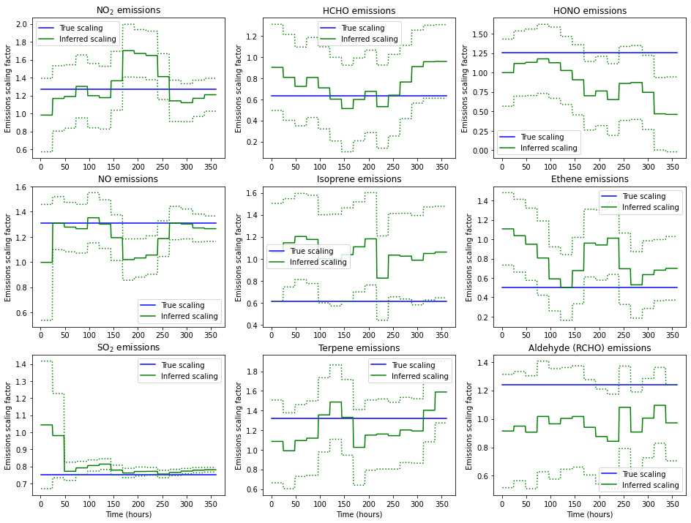
However, the emissions update is not terribly stable or accurate. This can vary wildly along with observation fluctuations.
We need to work out how to include additional prior restraints on emissions updates.
SO₂ (bottom left) looks good and stable because in SAPRC99 it has quite simple chemistry. We only really have to optimize SO₂ emissions based on SO₂ concentrations, which is not a hard problem.

Slide 30
Ensemble transform Kalman filter (ETKF)
The most important thing to know is that ETKF and EnKF have identical statistics and should lead to near identical results. The difference is that EnKF involves random perturbations of the observations, $y_{k}$, as many perturbations as there are ensemble members. This encodes the observation covariance matrix $R_{k}$ in the ensemble: $y_{i,k}=y_{k}+u_{i}$ for $u_{i}\sim 𝒩(0,R_{k})$. For example, in our NYC NO₂ column example, if we observe a value of 10¹⁶ molec/cm² with a standard deviation of 10¹⁵ molec/cm², then we would perturb that value as we form our perturbation matrices: ensemble member 15 might get a value of 9.95 x 10¹⁵, while ensemble member 23 might get a value of 1.05 x 10¹⁶. Again, this is just to avoid doing matrix operations on large covariance matrices.
However, there is a deterministic way to encode all the relevant information in the ensemble and do the update: the Ensemble transform Kalman filter (ETKF). I bring this up because ETKF is used in practice quite frequently, and is the method that Miyazaki uses. The technical details are not terribly important – just remember that when you read ETKF, think “deterministic EnKF.” However, the next two slides have the technical details that will help when I explain Miyazaki’s method in a few slides.

Slide 31
Details of the ensemble transform Kalman filter (ETKF)
Key linear algebra trick: $P_{b}$ is not invertible, but is one-to-one (and therefore “invertible”) on the space spanned by the perturbations $X_{k}^{f}$, which we will call $S$. So while the n x n matrix $P_{b}^{−1}$ does not exist in the full real space $ℝ^{n × n}$, it does exist in the subspace $S$ – this is related to the idea of the pseudoinverse. This means that we can minimize the 3D-Var/Kalman filter cost function (which requires $P_{b}^{−1}$) in $S$! This is where we should search for the ideal update.
Imagine we are in the analysis stage of EnKF. We have the ensemble anomalies $X_{k}^{f}$, which we recall are the difference between each ensemble member and the ensemble mean. The ensemble covariance matrix is then given by ${P_{b}=(m−1)}^{−1}X_{k}^{f}{(X_{k}^{f})}^{T}$ where m is the number of ensemble members. This is a matrix of rank $m−1$ because the columns of the perturbation matrix sum to 0, implying linear dependence. Again, $P_{b}$ should be thought of as a reduced-rank approximation of the true background covariance.
When you hear pseudoinverse, you may think “singular value decomposition.” But there is a cheaper way to compute this. Second linear algebra trick: treat $X_{k}^{f}$ as a linear transformation from m dimensional space $S′$ to $S$. Now imagine that $w∈S′$ is a Gaussian random vector with mean 0 and covariance ${\left(m−1\right)}^{−1}I$. Then we the random variable $x={\overline{x}}_{k}^{f}+X_{k}^{f}w$ as normally distributed with mean ${\overline{x}}_{k}^{f}$ and covariance $P_{b}$!
Now we can use some tricks to minimize the cost function, transformed to be a function of $w$ and not of $x$ (as we had in the 3D-Var section). Skipping the math, the analytic minimizer ${\overline{w}}^{a}$ is given by${\overline{ w}}^{a}={Q{(Y}_{k}^{f})}^{T}R_{k}^{−1}\left({y^{o} − \overline{y}}_{k}^{f}\right)$, where $y^{o}$are the real observations (like NO₂ columns) and ${\overline{y}}_{k}^{f}$ are the mean simulated version of those observations (ensemble average NO₂ columns). Here we have $Q={[\left(m−1\right)I+{{(Y}_{k}^{f})}^{T}R_{k}^{−1}Y_{k}^{f}]}^{−1}$.

Slide 32
Details of the ensemble transform Kalman filter (ETKF), continued.
Define $W^{a}={[\left(m−1\right)Q]}^{1/2}$ according to the symmetric square root. Then the analysis ensemble perturbation matrix $X_{k}^{a}$ is given by $X_{k}^{a}={X_{k}^{f}W}^{a}$. This matrix informs us how each ensemble member deviates from the analysis ensemble mean ${\overline{x}}_{k}^{a}$. So in our example, we simply add the analysis perturbations $X_{k}^{a}$ to the updated mean ${\overline{x}}_{k}^{a}$ to get 32 full GEOS-Chem run states, which we can then use to run the models until the next observation arrives!
The square root $W^{a}$ has some useful properties, like ensuring the columns of $X_{k}^{a}$ sum to zero and that $W^{a}$ depends continuously on $Q$. The latter property is vital for the parallelization that we will do later (Miyazaki’s preferred method).
Transforming from the minimizer space $S′$, where $w$ is defined, to the model space $S$, we obtain the updated ensemble mean ${\overline{x}}_{k}^{a}={\overline{x}}_{k}^{f}+X_{k}^{f}{\overline{ w}}^{a}$. However, we aren’t done yet. We need to update all of our ensemble members appropriately!

Slide 33
A brief overview of the Ensemble Kalman Smoother (EnKS)
So far we have been talking about the Ensemble Kalman Filter (EnKF). EnKF apparently updates the estimate at a particular time based only on the present measurement. However, our covariance matrices (emulated by the ensemble of model runs) contain the relevant information from all past observations, so we really are updating our ensemble using present and past measurements. However, if we are doing a reanalysis, we would might like to update the estimate at a particular time based on all measurements, past, present, and future. This can be done with a related method, the Ensemble Kalman smoother (EnKS). We don’t need to cover the details now, but this method is a consistent way of computing static model parameters, such as emissions scaling factors. It does not appear to be used very often in the literature, but is theoretically quite nice.

Slide 34
Summary of the data assimilation zoo so far
3D-Var and 4D-Var
Kalman filters
How they work in practice:
Run model until observation
Assimilate observation
Continue until next observation
How they work in practice:
Run model for ~6 hours
Collect all observations in ~6hr period
Assimilate by minimizing a cost function
3D-Var
4D-Var
Unlike 3D-Var and 4D-Var, Kalman filters allow for
Imperfect models
Preservation and updates of error information
Stationary: assimilate at one point in time. Can only update initial conditions based on simultaneous observations.
Variability: assimilate at all points throughout the window via one run of forward and one run of adjoint model.
Extended Kalman filter (EKF)
Ensemble Kalman filter (EnKF)
Allows nonlinearities
Theoretically equivalent to 4D-Var, under conditions of perfect model
Computationally intractable
Allows nonlinearities and (some) non-Gaussian representation
Similar computationally to 4D-Var, but no adjoint
First guess at appropriate time: Interpolate forecast to assimilate observations throughout the window, without use of adjoint.

Slide 35
Operationalizing EnKF for chemistry
Remember the EnKF example with the 32 GEOS-Chem simulations run in parallel? When we did the update step, we had to perform some very expensive operations on an enormous state vector (concentrations for all species in every gridcell in the 3D model, plus emissions scaling factors). Not only is this expensive, many of the computations are worse than useless. Since we aren’t perturbing every emission scaling factor individually, as we would if we were constructing the Jacobian, we are in a degenerate subspace of the error covariance. We should expect many spurious correlations to emerge, especially at long range, because of this degeneracy. Ideally we would like to limit the range of influence of each gridcell, perhaps with different distances for different species (CO should have a wider range of influence than NO₂, for example). This is the idea behind the Localized Ensemble Transform Kalman Filter (LETKF), used by Miyazaki at JPL to compute emissions updates for many reactive species!
Here’s how it works: we run the full 32 GEOS-Chem simulations. But when it comes time to assimilate an observation, we parallelize the update process. Rather than the enormous state vector representing all concentrations and emissions in the global 3D-model, we make many “baby” state vectors. For each grid point in the model, we define a “localization cylinder.” This cylinder contains relevant concentration information that influences this grid point.

Slide 36
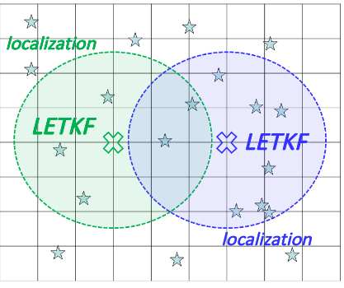
Localized Ensemble Transform Kalman Filter (LETKF)
Example “baby” state vector for localization about point X
Concentration field from GEOS-Chem
Suppose we want to simultaneously update NO₂ concentrations and emissions. Then for every surface gridcell we do the following:
Construct a “baby” state vector as a subset of the full GEOS-Chem ensemble of runs. The green squares below represent relevant concentrations in a “cylinder of influence” surrounding the the point X, which we will be updating. These surrounding points only provide information for us to use in the construction of the localized background covariance matrix: we do not update the green squares! They will be updated separately in their own “baby state vector” optimization. For NO₂, these might be concentrations of NO_{x}, VOCs, ozone, etc. These surrounding concentrations tell us how, in the model, the NO₂ emissions and concentrations at point X relate to their surroundings. For example, if we observe some high ozone downwind, these help us know how to update NO2 at point X. From this we do a baby EnKF optimization, which allows us to update only the emissions and concentrations at point X.
localization radius
Emissions and conc.
at point X
point Y
NO₂ emissions at point X
X
X
Relevant concentrations within
localization radius
NO₂ concentrations
at point X
http://www.data-assimilation.riken.jp/isda2019/program/slides/7-3.pdf

Slide 37
Localized Ensemble Transform Kalman Filter (LETKF)
Example “baby” state vector for localization about point Y
Concentration field from GEOS-Chem
We repeat this “baby” EnKF process at every single gridcell in the model. This is an “embarrassingly parallel” operation. Take a look, for example, at point Y at right. To update NO₂ concentrations and emissions at point Y, we compute a separate “localization cylinder” of concentrations at surrounding gridcells that might be related to point Y. From this, we compute a separate “baby EnKF” analysis, resulting in different ensemble and observational anomalies and a different update. For example, point Y may be far more sensitive to a third point Z than point X is, and thus the Y-Z covariance values will be higher than the X-Z values. However, because point X and point Y are updated in this “embarrassingly parallel” manner, we never have a conflict. The covariance matrices are separate, and the update is separate. LETKF is no different from EnKF: it merely parallelizes the process, so each gridcell’s sensitivities and influences are processed separately, rather than in one enormous covariance matrix.
localization radius
Emissions and conc.
at point X
point Y
NO₂ emissions at point Y
Y
Y
Relevant concentrations within
localization radius
NO₂ concentrations
at point Y
http://www.data-assimilation.riken.jp/isda2019/program/slides/7-3.pdf

Slide 38
Localized Ensemble Transform Kalman Filter (LETKF)
State vector for left localization (point X)
X
Emissions at point X
Relevant concentrations within
localization radius
Concentration field
Covariance matrix derived from the ensemble
X
X
X
Matrix links unobserved
emissions to observed
concentrations
Emissions at point X
point Y
X
X
X
X
X
X
X
X
X
X
X
X
X
X
X
http://www.data-assimilation.riken.jp/isda2019/program/slides/7-3.pdf

Slide 39
An imaginary LETKF scenario explained in detail
Observations arrive! It’s 10,000 satellite NO₂ columns over the world. First, we must simulate the observations in each of our GEOS-Chem runs to compare them with the observations. This is done via the H operator. In this case, H might mean we integrate the columns of each model run and apply the satellite averaging kernel.
Run GEOS-Chem 32 times in parallel. In each instance, start with a randomly perturbed emissions field! For example, we might randomly choose scaling factors between 0.25 and 1.75 for every gridcell in the model. These could be independent (white noise) or reflect some prior knowledge of error covariance.
x 32
Run full models in parallel until an observation arrives
Now we calculate the mean ${\overline{x}}_{k,globe}^{f}$of the 32 ensemble members’ full states, including 3D concentrations of all relevant species and relevant emissions scaling factors. Suppose this is of length 1,000,000. Then the normalized observation anomalies $X_{k,globe}^{f}$ are the difference between each element in the state vector of each of the 32 GEOS-Chem runs and the ensemble mean state ${\overline{x}}_{k,globe}^{f}$. $X_{k,globe}^{f}$ will be a 1,000,000 x 32 matrix, reflecting the difference from the ensemble average of each GEOS-Chem run.
Now we calculate the mean ${\overline{y}}_{k, globe}^{f}$of each of the 10,000 simulated columns across the 32 model runs. Now we have 10,000 “average columns” – our best guess of reality. We can subtract each ensemble members predicted columns from this average to obtain the “normalized observation anomalies” $Y_{k,globe}^{f}.$ This is a 10,000 x 32 matrix, reflecting the difference between the ensemble average and each modeled column.
Until now, we have done essentially normal EnKF/ETKF. Things change on the next slide.

Slide 40
An imaginary LETKF scenario explained in detail (cont.)
Localize the global observation anomaly matrix $Y_{k,globe}^{f}$ and the global ensemble anomaly matrix${ X}_{k,globe}^{f}$to a given grid point. We will do this in a massive, embarrassingly parallel operation. Imagine that for NO₂ optimization, our radius of influence is 600 km with a height ranging up to 500 hPa. Then to optimize NO₂ emissions and concentrations at a gridpoint on the surface, we select a subset of ${ X}_{k,globe}^{f}$ corresponding to gridcells in a cylinder surrounding our point of reference, with radius 600 km and height ~ 500hPa. Suppose 1000 model points are in this region. Call this local subset ${ X}_{k,local}^{f}$, which has dimension 1,000 x 32 matrix . Similarly, we select observations within this region (suppose there are 10 of them), and call the local subset $Y_{k,local}^{f}$, which has dimension 10 x 32. Subset the actual observations to obtain a vector of 10 true columns $y_{k,local}^{obs}$ and the actual observation covariance matrix $R_{k, globe}$ to the local 10 x 10 matrix $R_{k, local}$. For clarity, review slides 31-32.
Compute the length 32 vector ${\overline{w}}_{local}^{a}$ by computing ${\overline{w}}_{local}^{a}=$ ${Q_{local}C}_{local}$($y_{k,local}^{obs}$- ${\overline{y}}_{k, local}^{f})$. Then multiply ${ X}_{k,local}^{f}$ by ${\overline{w}}_{local}^{a}$ to get the new local analysis ensemble mean: ${\overline{x}}_{k, local}^{a}={\overline{x}}_{k, local}^{f}+X_{k, local}^{f}{\overline{w}}_{local}^{a}$. We add this to the local analysis anomalies $X_{k, local}^{a}=X_{k, local}^{f}W_{local}^{a}$ to obtain the new analysis ensemble.
Compute the 32 x 10 matrix $C_{local}= {(Y_{k,local}^{f})}^{T}{\left[R_{k, local}\right]}^{−1}$
Repeat the process on this slide for every gridpoint in the global state vector that we would like to optimize. This is “embarrassingly parallel” because each update is entirely independent. After each gridcell is updated, combine all updates into a new global state vector and run GEOS-Chem 32 times in parallel until the next observation arrives.
Use $C_{local}$ to compute the 32 x 32 matrix $Q_{local}={[\left(32−1\right)I+C_{local} Y_{k,local}^{f}]}^{−1}$
Use $Q_{local}$ to compute the 32 x 32 matrix $W_{local}^{a}={[\left(32−1\right)Q_{local}]}^{1/2}$

Slide 41
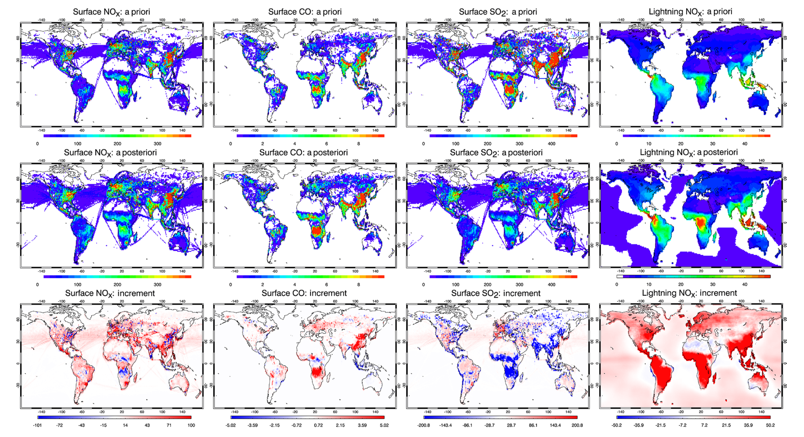
LETKF real-life example: Miyazaki’s method
Each emission scaling factor optimized independently in the LETKF process! From Miyazaki et. al., 2020.

Slide 42
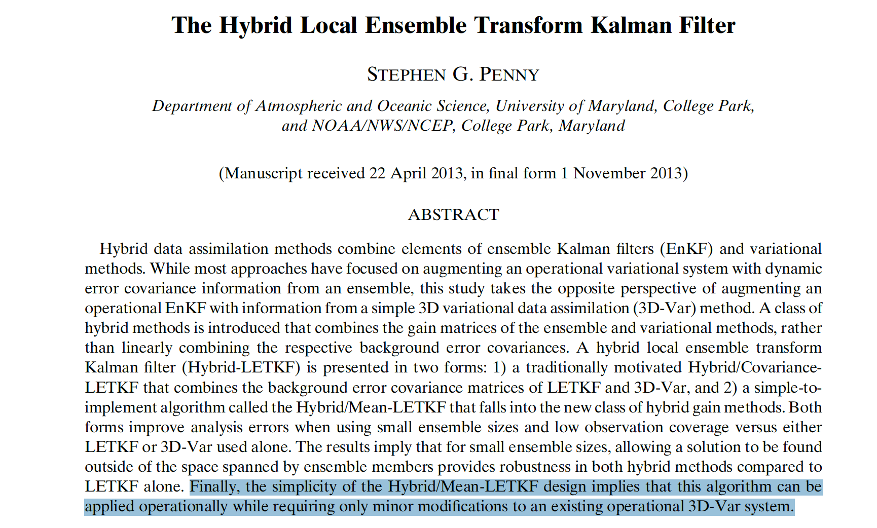
Hybrid methods are becoming increasingly explored as ways of fusing ensembles with existing variational DA systems: ideal for chemistry after GSI->JEDI switch.

Slide 43
Future of CDA, powered by neural network emulation of GEOS-Chem
Imagine that in a 3D-Var/LETKF hybrid model, we use the full GEOS-CF model for the 3D-Var portion of the update, but for the ensemble of simulations in LETKF we use Makoto’s neural network emulation of GEOS-Chem plugged into GEOS5. This would drastically cut down on the computational costs of evolving this ensemble, aided by the fact that hybrid methods require fewer ensemble members due to the information provided by 3D-Var. This puts a hybrid 3D-Var/LETKF model well within our capacities.
Moreover, there exist methods called “particle filters” which fully generalize data assimilation to highly non-linear, non-Gaussian contexts. While all the methods we have discussed so far implicitly assume some degree of linearity and Gaussian statistics (in that they work only with the first and second moments of the PDF), particle filters can evolve arbitrary PDFs in a Monte Carlo approximation of the Fokker-Planck equation. Particle filters are not used in practice because they require a large number of ensemble members. However, with neural network emulation, they may be approaching the realm of possibility. This would give us a great ability to work with complex PDFs in a rigorous way, like the bimodal distribution of particle sizes.

