Slide 1
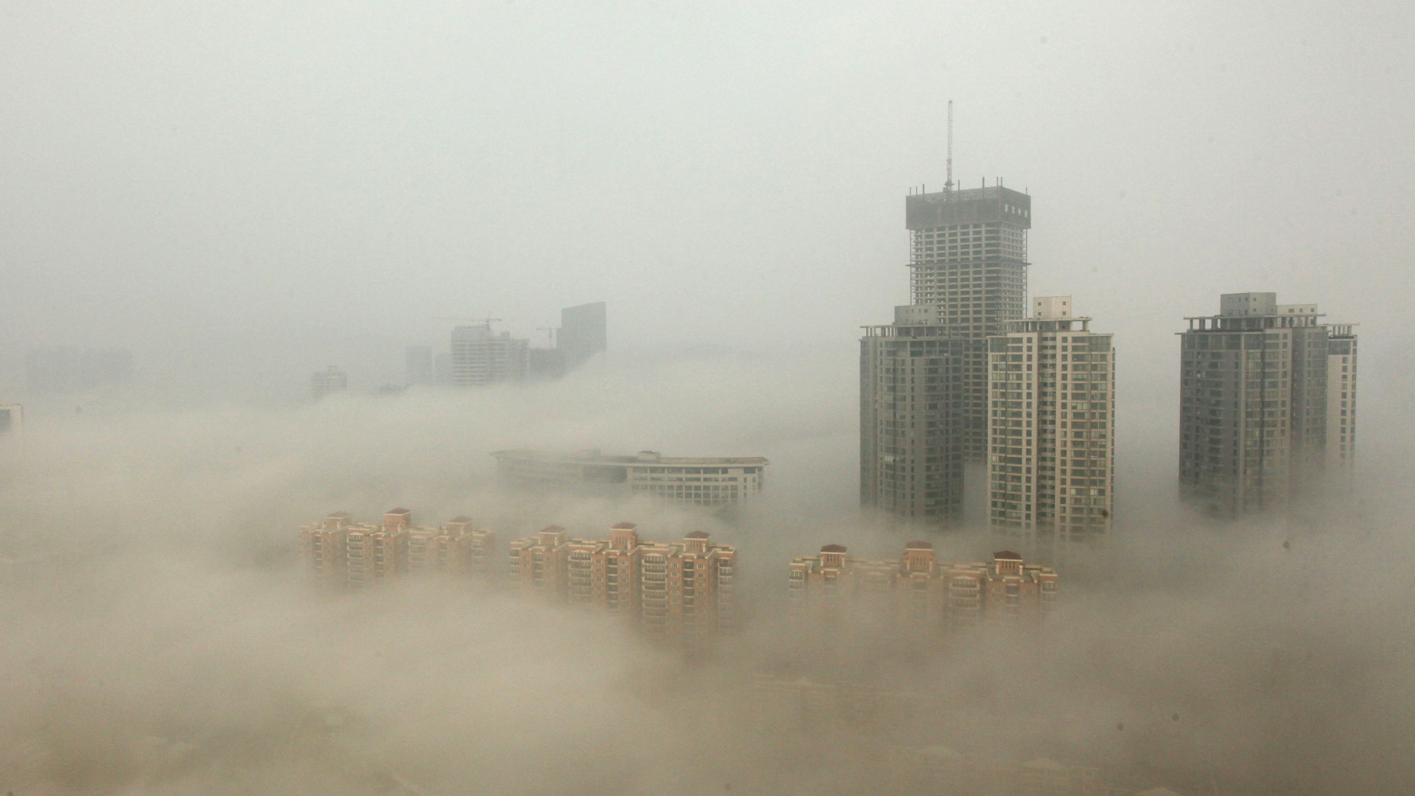
Modeling the impact of strong regulation of near-term climate forcers in China on mid-21st century air quality and climate using a coupled Earth system model
Drew C. Pendergrass^{1,2}, Larry W. Horowitz³, and Vaishali Naik³
¹Harvard College, ²NOAA Hollings Scholarship Program, ³NOAA Geophysical Fluid Dynamics Laboratory (GFDL)

Slide 2
Motivation: China’s current air quality dilemma
Near-term climate forcers (NTCFs) are a major source of uncertainty in estimating changes to Earth’s energy balance. Moreover, NTCFs, including tropospheric ozone and fine particulate matter (PM_{2.5}), cause serious public health burdens, especially in eastern China.
The Chinese government, responding to severe smog problems, implemented the Action Plan on Air Pollution Prevention and Control in 2013.
China rapidly reduced emissions of ozone precursors like NO_{x} and aerosol precursors like SO₂. Wonderful news!
However, observations show that while fine particulate matter (PM_{2.5}) has decreased, surface ozone has increased, even though emissions have fallen.
We want to understand what this ozone/PM_{2.5} tradeoff might look like in the mid-21st century, what mechanisms might drive the tradeoffs, and the implications for global air quality and climate.

Slide 3
Outline
Introduction and model description
PM_{2.5} and ozone tradeoffs in China and their relations to emissions
Air quality implications of Chinese NTCF regulations for nearby nations
Climatic effects of Chinese NTCF regulations
Conclusion and questions

Slide 4
Outline
Introduction and model description
PM_{2.5} and ozone tradeoffs in China and their relations to emissions
Air quality implications of Chinese NTCF regulations for nearby nations
Climatic effects of Chinese NTCF regulations
Conclusion and questions

Slide 5
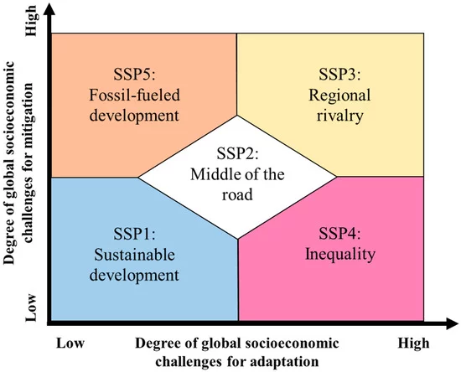
What do we assume about the future?
For this study, we analyze the future under Shared Socioeconomic Pathway 3.
Assumes an emphasis on competition and security fractures global cooperation.
Base model leads to radiative forcing of ~7.0 W m⁻², so call scenario SSP370
We compare this baseline to a scenario where China aggressively regulates NTCF emissions, but everyone else carries on (SSP370-China-lowNTCF).
For sensitivity studies, we also consider the case where the entire world aggressively regulates NTCF emissions (SSP370-lowNTCF)
Figure: Sellers and Ebi 2018

Slide 6
Emissions comparison under three policy scenarios

Slide 7
Model description
We use the Geophysical Fluid Dynamics Laboratory Earth System Model version 4.1 (GFDL-ESM4.1) to study the past and future climate
We prescribe emissions using output from the Asia-Pacific Integrated Model/Computable General Equilibrium version 2 (AIM/CGE)
GFDL-ESM4.1 includes a fully interactive carbon cycle and interactive atmospheric chemistry, and is coupled with ocean and sea ice modules among other Earth system processes

Slide 8
Outline
Introduction and model description
PM_{2.5} and ozone tradeoffs in China and their relations to emissions
Air quality implications of Chinese NTCF regulations for nearby nations
Climatic effects of Chinese NTCF regulations
Conclusion and questions

Slide 9
NTCF emission reductions would, on balance, decrease surface PM_{2.5} but increase surface ozone by midcentury
SSP370-China-lowNTCF – SSP370
SSP370-China-lowNTCF – SSP370
Mean year-round air quality shift due to implementing strong NTCF regulations over period 2045-54

Slide 10
While PM_{2.5} decreases are consistent year-round, ozone concentration shifts vary seasonally and across space, and are especially different in summer (JJA)
SSP370-China-lowNTCF – SSP370

Slide 11
While PM_{2.5} decreases are consistent year-round, ozone concentration shifts vary seasonally and across space, and are especially different in summer (JJA)
Urban effect: Beijing/North China Plain, Shanghai/Yangtzee River, and Hong Kong/Pearl River Delta don’t match countryside trends in summer
SSP370-China-lowNTCF – SSP370

Slide 12
In east China (EC), for the SSP370 run, ozone increases slightly throughout the year.
North China Plain (NCP) is exception; ozone increases uniformly even in summer in the SSP370-China-lowNTCF run
In the SSP370-China-lowNTCF run, ozone increases greatly every part of the year except summer

Slide 13
Why do ozone and PM_{2.5} go in opposite directions when precursors are reduced in the low NTCF policy scenario?
For 2045-54, subtract the monthly mean NO_{x} and O₃ values for each grid cell in east China, disaggregate, and plot
Do the same for monthly mean PM_{2.5}

Slide 14
Why do ozone and PM_{2.5} go in opposite directions when precursors are reduced in the low NTCF policy scenario?
Outside of summer, we are in the regime where an decrease in NO_{x} results in an increase in O₃
However, in summer, the relationship largely vanishes

Slide 15
Why do ozone and PM_{2.5} go in opposite directions when precursors are reduced in the low NTCF policy scenario?
Outside summer, in the regime where an decrease in PM_{2.5} results in an increase in O₃ and vice versa
Again, in summer, the relationship largely vanishes
Raises the question: Which effect is dominant?

Slide 16
Aerosol regulations only
(weak NO_{x} emission controls)
SSP370-China-lowAER – SSP370
SSP370-China-lowAER – SSP370
To investigate, we run an additional simulation where aerosol precursors, but not NO_{x} or other ozone precursors, are regulated according to the low-NTCF emissions scenario (SSP370-China-lowAER)

Slide 17
Aerosol regulations only
(weak NO_{x} emission controls)
PM_{2.5} aerosols have weak effect
SSP370-China-lowAER – SSP370
SSP370-China-lowAER – SSP370
All NTCFs regulated
(strong NO_{x} emission controls)
SSP370-China-lowNTCF – SSP370
SSP370-China-lowNTCF – SSP370

Slide 18
Outline
Introduction and model description
PM_{2.5} and ozone tradeoffs in China and their relations to emissions
Air quality implications of Chinese NTCF regulations for nearby nations
Climatic effects of Chinese NTCF regulations
Conclusion and questions

Slide 19
South Korea and Japan to see significant benefits in winter PM_{2.5} from strong Chinese emission controls
Transport of Chinese PM_{2.5} has significant impact on winter air quality in South Korea and Japan
DJF South Korean PM_{2.5} reduced by 13% if only China cuts. If the whole world follows lowNTCF path, then 28% of South Korea’s winter PM_{2.5} reductions can be attributed to Chinese regulation alone
DJF Japanese PM_{2.5} reduced by 10% if only China cuts. If the whole world follows lowNTCF path, then 33% of Japan’s winter PM_{2.5} reductions can be attributed to Chinese regulation alone

Slide 20
At least in South Korea, however, there is a winter ozone penalty that reverses in summer (2045-54 mean seasonal cycles)

Slide 21
Outline
Introduction and model description
PM_{2.5} and ozone tradeoffs in China and their relations to emissions
Air quality implications of Chinese NTCF regulations for nearby nations
Climatic effects of Chinese NTCF regulations
Conclusion and questions

Slide 22
Implementing strong air quality policy does not appear to have a major impact on climate
SSP370-China-lowNTCF – SSP370
SSP370-China-lowNTCF – SSP370
Shift due to implementing strong NTCF regulations over period 2040-59
Temperature and net downward radiation (RTMT) are most substantial shifts; radiative forcing is computed with prescribed SSTs to ensure only atmospheric effects are considered
No substantial shift in precipitation, East Asian Winter Monsoon (EAWM), or Siberian high

Slide 23
Conclusions
NTCF emission reductions would, on balance, decrease surface PM_{2.5} but increase surface ozone by midcentury in China.
Benefits of Chinese emission reductions in PM_{2.5} are felt in neighboring countries, but so is the ozone tradeoff (at least for South Korea).
However, with the exceptions of urban areas, in the summer NTCF emission reductions would work to decrease surface ozone.
While both PM_{2.5} and NO_{x} reductions generally imply an increase in surface ozone, NO_{x} regulations would be more responsible for the increase in midcentury surface ozone under a strong NTCF emissions policy.
NTCF regulations in China do not appear to substantially affect large circulation patterns, although reduced NTCFs would drive up to a half degree of surface warming in China

Slide 24
Acknowledgements
This work was supported and funded by the NOAA Ernest F. Hollings Scholarship and was conducted at the Geophysical Fluid Dynamics Laboratory. All simulations were run on the Gaea cluster at Oak Ridge National Laboratory.
Special thanks to my mentors and coauthors Larry Horowitz and Vaishali Naik, as well as to Song-Miao Fan, Fabien Paulot, and Chris Blanton for their support and advice.
And thanks to the rest of the 2019 GFDL intern class!

Slide 25
Questions?

Slide 26
Extra slides

Slide 27
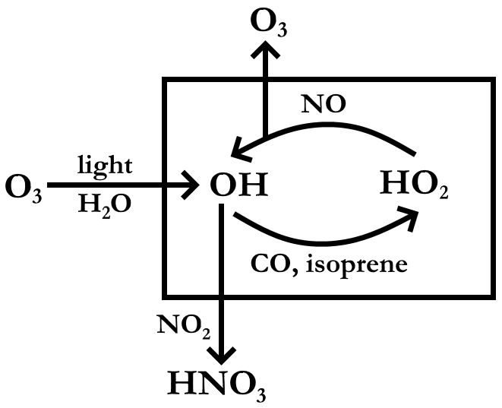
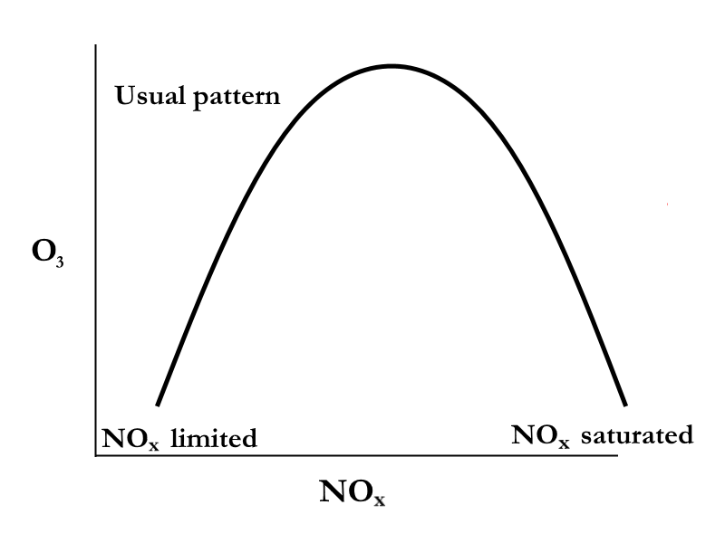
A one-minute crash course in atmospheric chemistry
More radiation
and humidity in summer implies
more O₃ production
Nitric oxide critical to O₃ production
Nitric acid rains out, limits O₃ production
NO_{x} vital for both production and loss of O₃

Slide 28
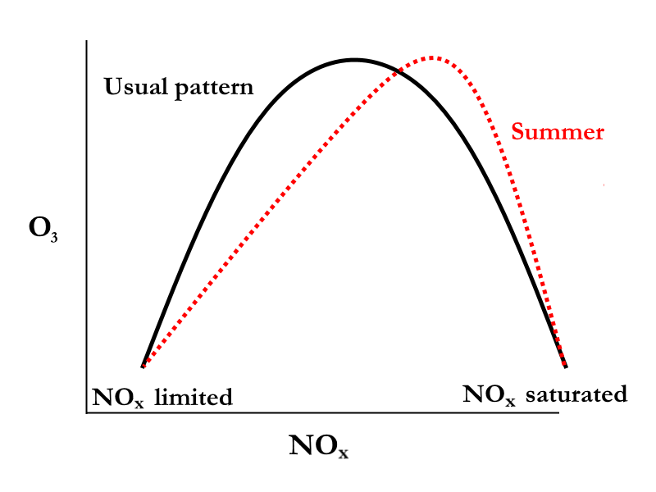
A one-minute crash course in atmospheric chemistry
More radiation
and humidity in summer implies
more O₃ production
Nitric oxide critical to O₃ production
NO_{x} saturation occurs at higher concentrations in summer
Nitric acid rains out, stops O₃ production
NO_{x} vital for both production and loss of O₃

Slide 29
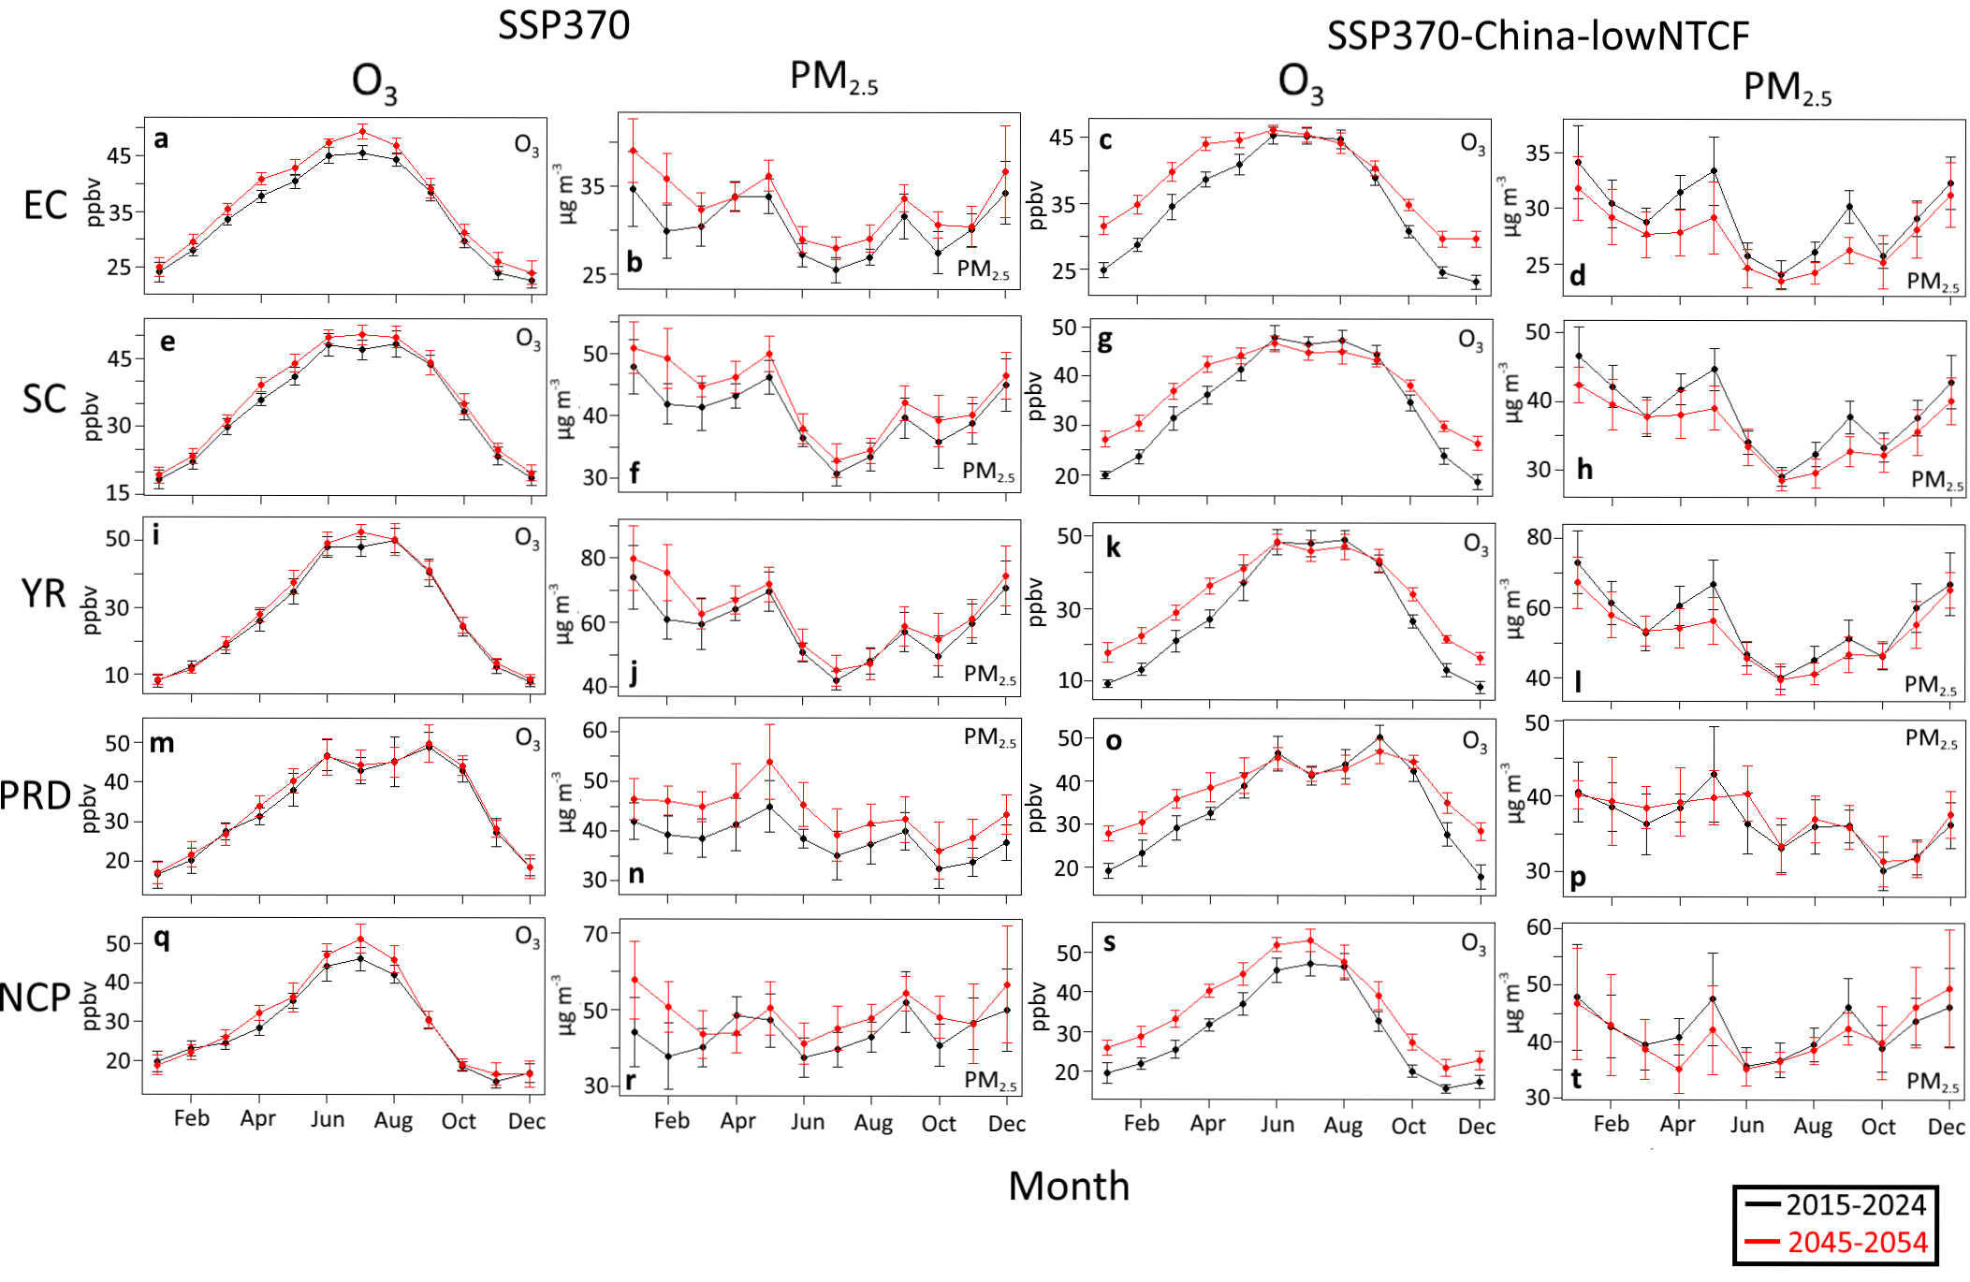

Slide 30
