Slide 1


High spatiotemporal resolution trends of PM_{2.5} in East Asia inferred from the GOCI geostationary instrument, 2011-2020
Drew Pendergrass | GEMS Meeting
September 8, 2023 with Daniel J. Jacob, Yujin Oak, Jhoon Kim, Jeewoo Lee, Seoyoung Lee, Shixian Zhai, and Hong Liao
Notes:
Outline: We’ll start by talking about why care about particulate matter and why using satellites is appealing for modeling. Then we’ll describe the random forest algorithm and discuss its accuracy. Finally we’ll spend some time exploring the results and discussing what it tells us about particulate air quality in East Asia. The background are my modelled predictions for annual PM in Korea from 2015 to 2019.

Slide 2
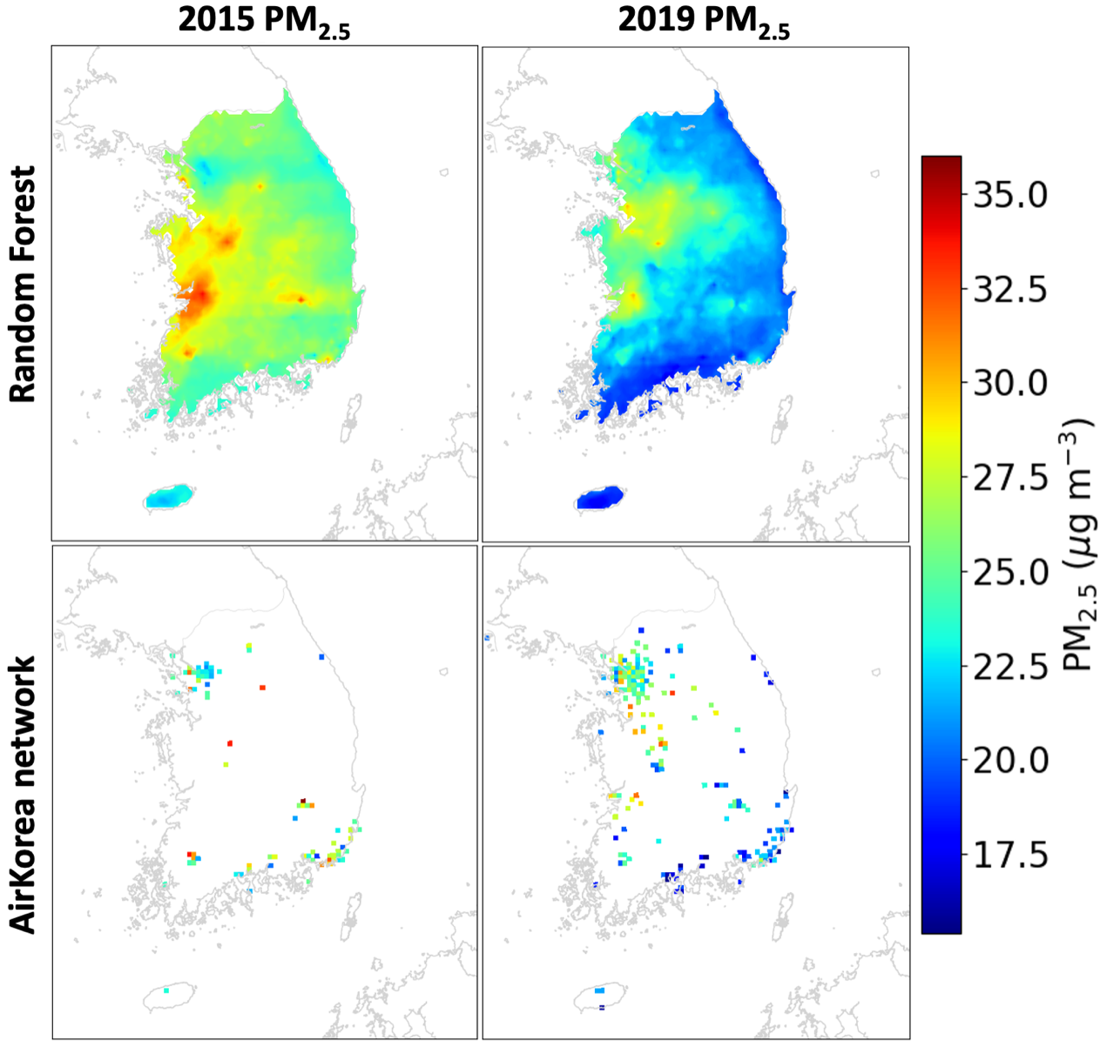
Previous work used GOCI 6x6 km² AOD retrieval to infer daily PM_{2.5} in East Asia via a machine learning method
GOCI PM_{2.5} v1.0 generated continuous PM_{2.5} fields using a random forest trained on AOD, surface PM_{2.5}, and covariates.
Pendergrass et al., 2022

Slide 3
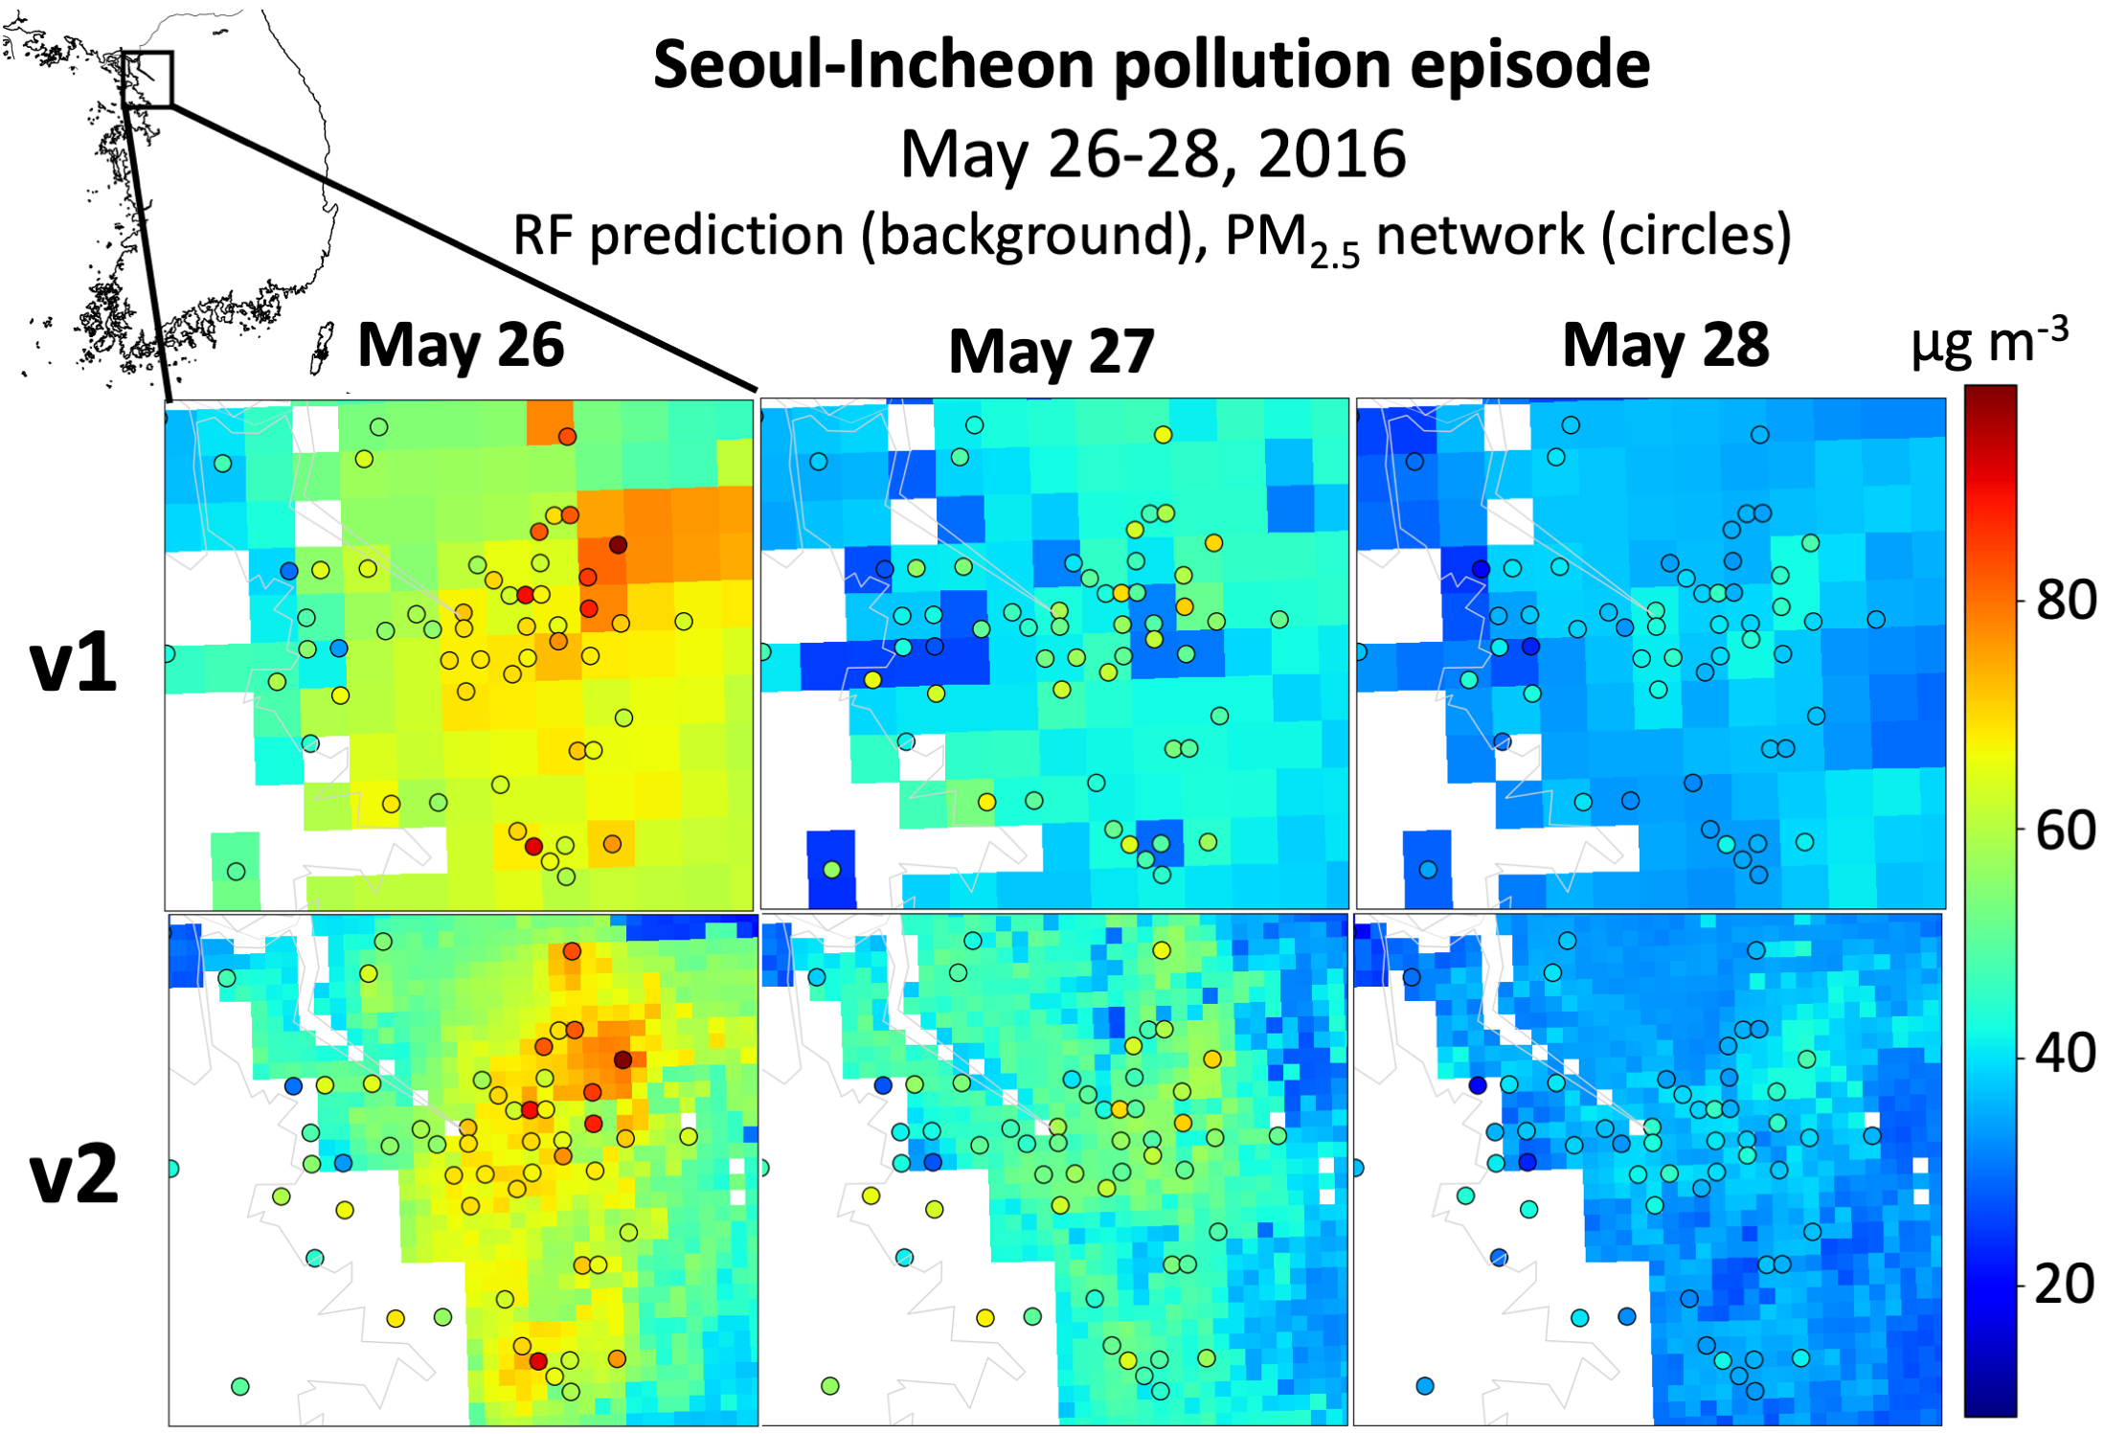
A new 2x2 km² GOCI AOD retrieval enables sharper product:
GOCI PM_{2.5} v2.0

Slide 4
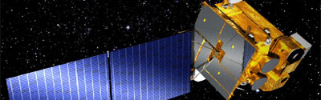


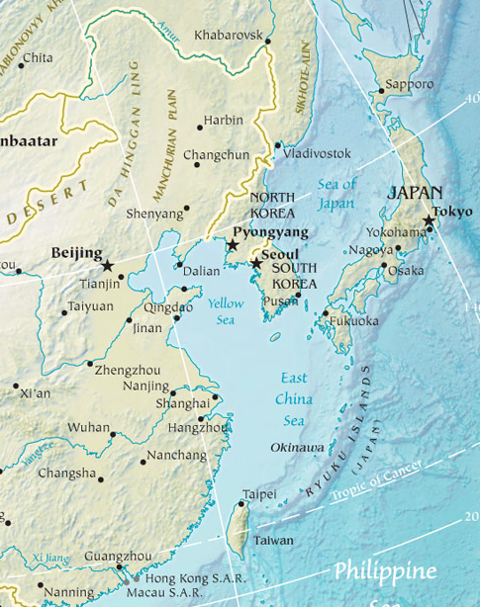
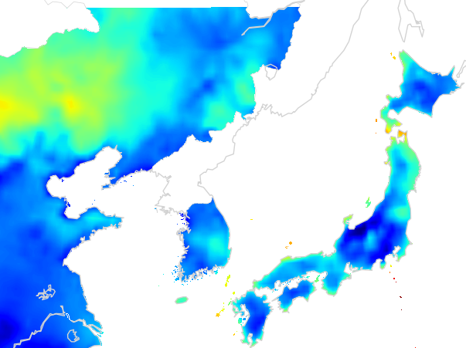
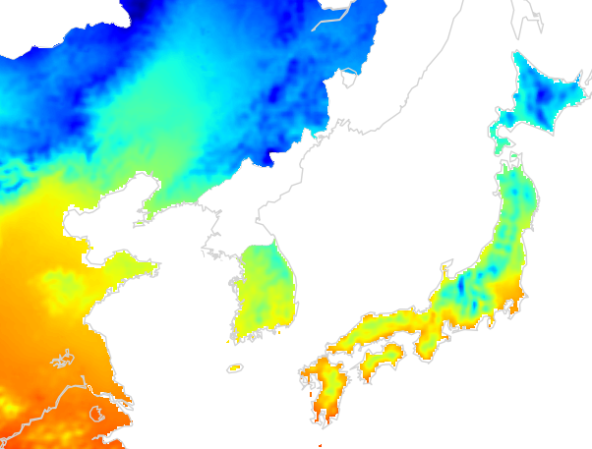
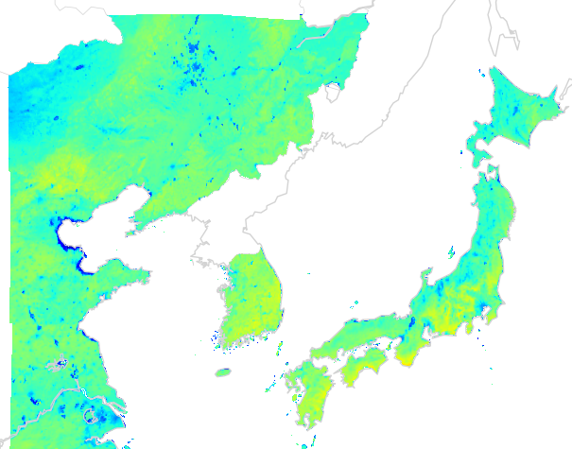

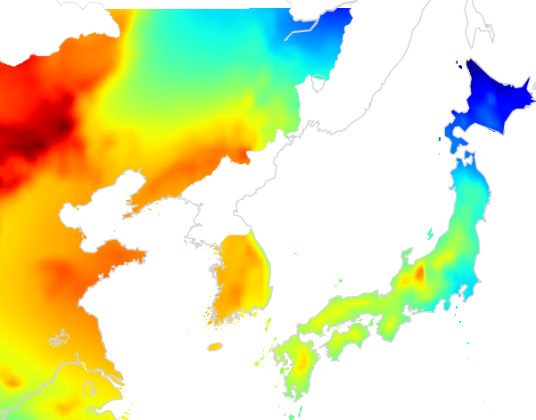
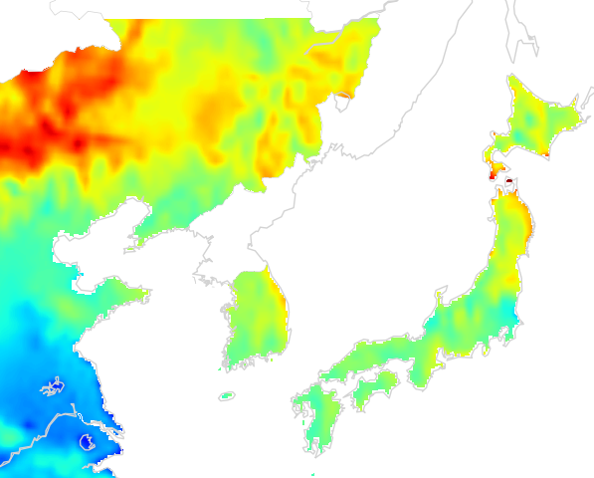
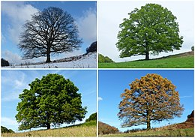

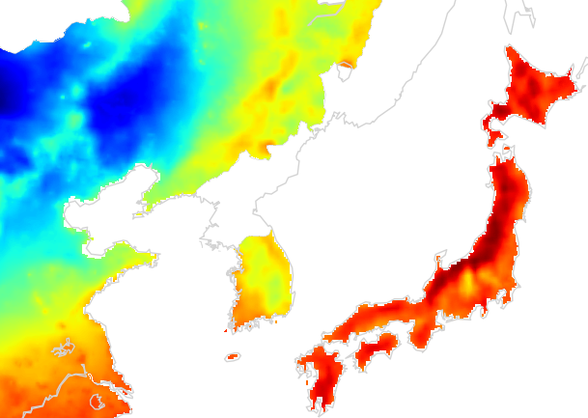
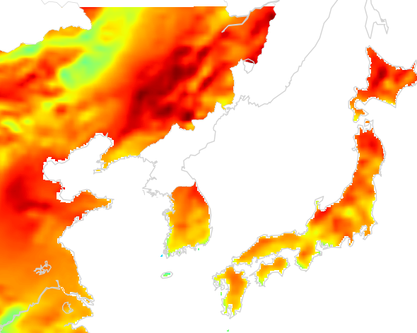




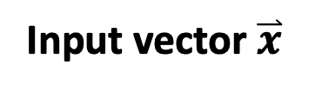
Data for training GOCI PM_{2.5} v2.0
Input vector $\overset{⃑}{x}$
Target value y
GOCI AOD and gap-filling information
Emissions and CTM monthly means
Ground PM_{2.5} data
24-hr average taken
at each site
Meteorology
Landcover and metadata
AirKorea PM_{2.5} (2015-20) +
Est. from PM₁₀ (2011-20)
Boundary level height
Temperature
Land cover type
NDVI
NIES (2011-20)
Sea level pressure
U winds
Elevation
Day of year
China MEE (2014-20) +
US Embassies (2011-20)
Relative humidity
V winds
Population
Nation

Slide 5
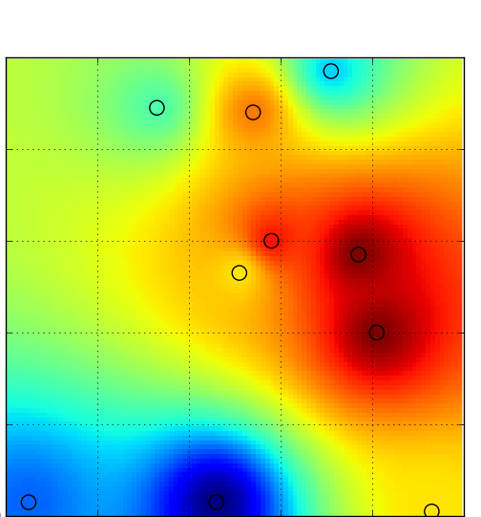
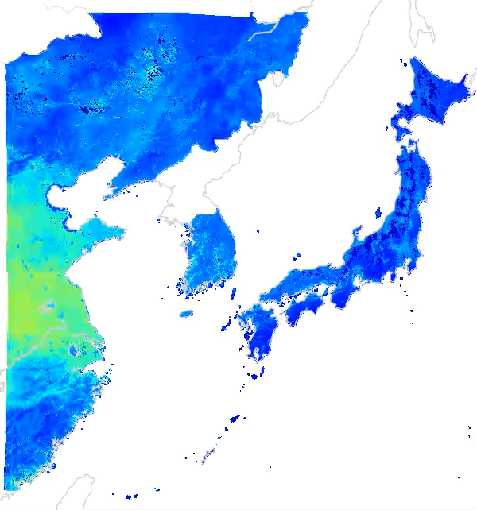
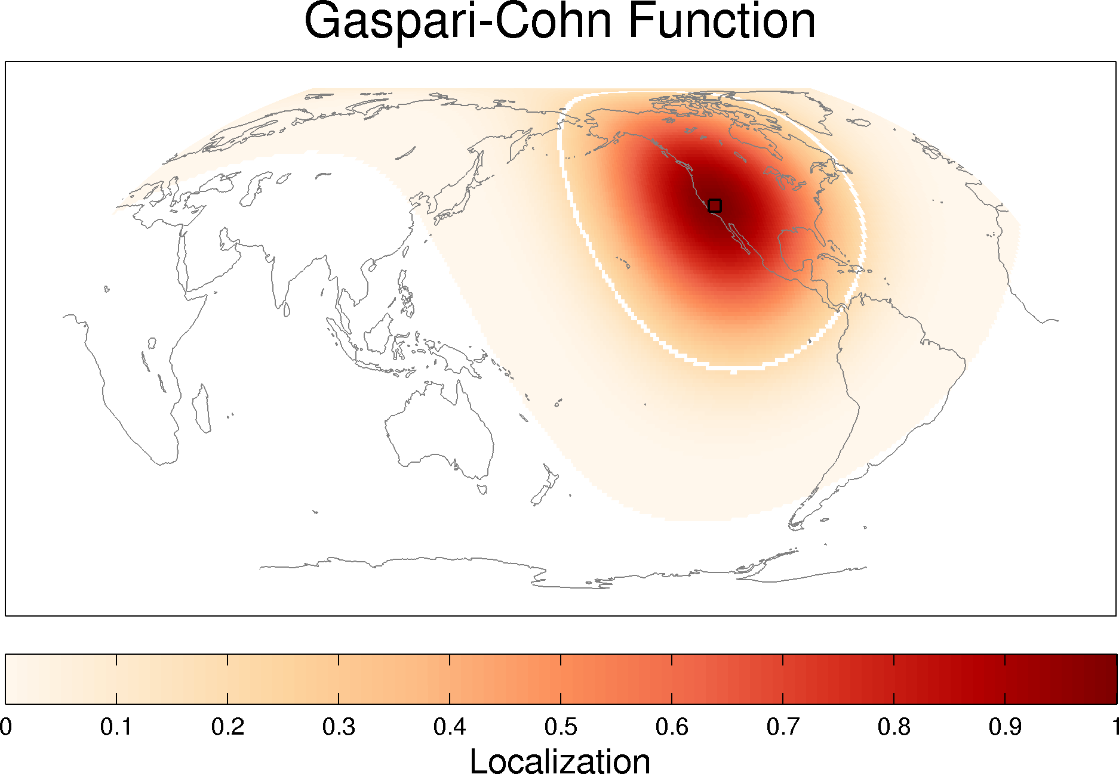
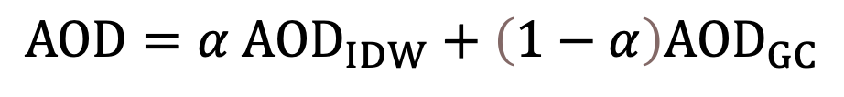

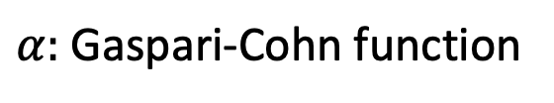

v1.0 AOD gap filling: statistical interpolation + chemical transport model
$$AOD=α {AOD}_{IDW}+\left(1−α\right){AOD}_{GC}$$
${AOD}_{GC}:$GEOS-Chem avgs.
${AOD}_{IDW}:$IDW interp.
$α:$Gaspari-Cohn function

Slide 6
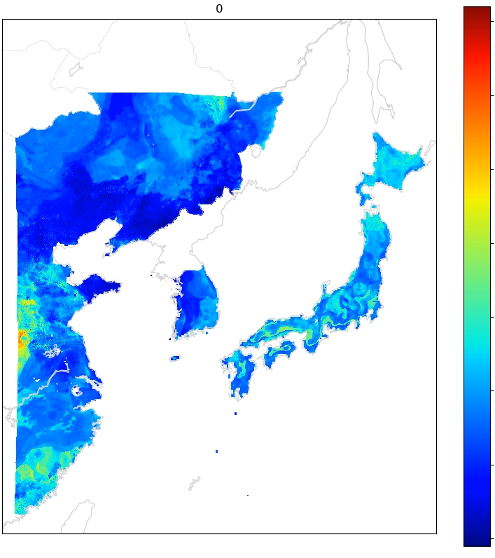
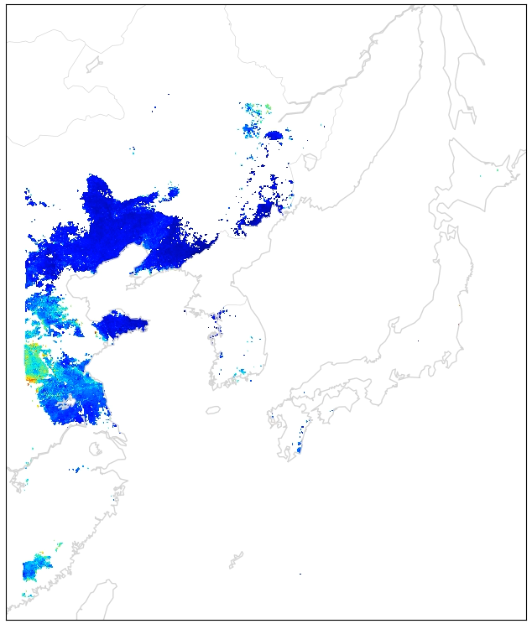
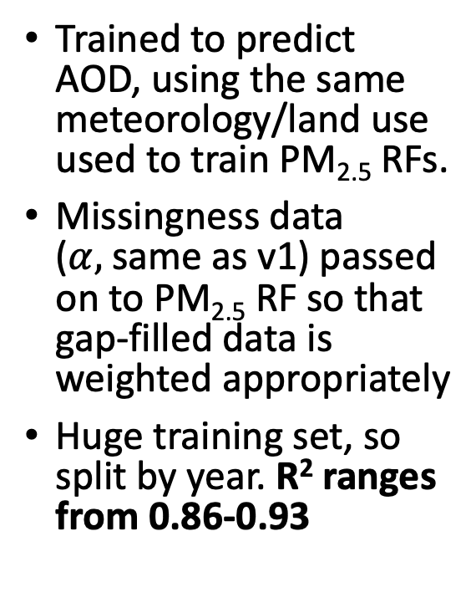
v2.0 AOD gap filling: separate random forest, use GEOS-Chem AOD as additional covariate
Separate RF fit
Retrieved AOD
Filled AOD
Trained to predict AOD, using the same meteorology/land use used to train PM_{2.5} RFs.
Missingness data ($α,$same as v1) passed on to PM_{2.5} RF so that gap-filled data is weighted appropriately
Huge training set, so split by year. R² ranges from 0.86-0.93
3
2
1
Yonsei U. retrieval
AOD for inferring PM_{2.5}
0
Notes:
(follows new framework from Joel Schwartz’s group

Slide 7
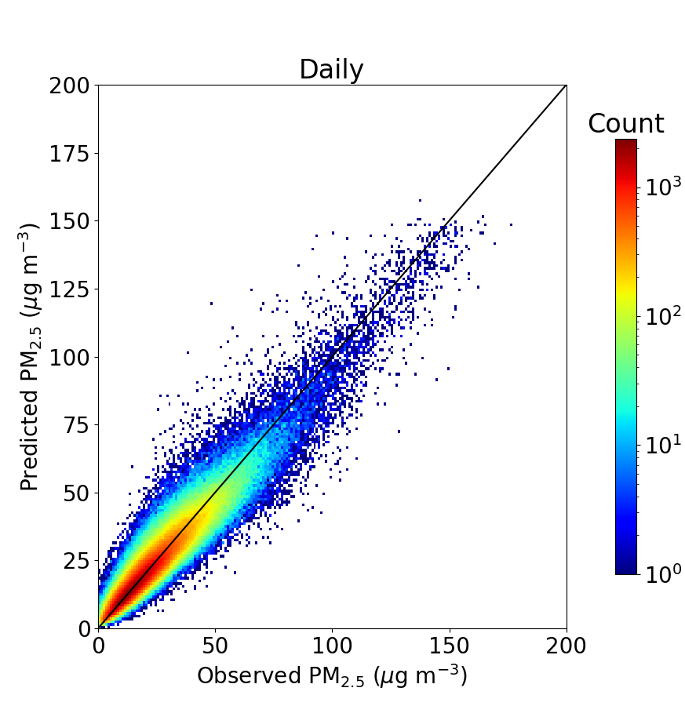
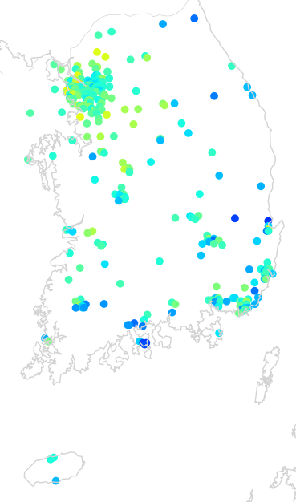
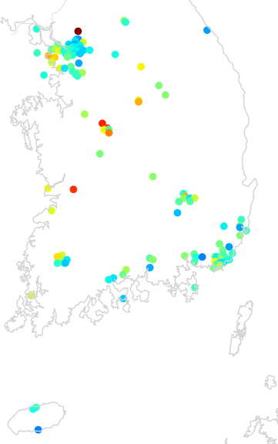
v2.0 extrapolation: in Korea, train on pre-2015 PM_{2.5} inferred from PM₁₀ in Korea
PM₁₀
Separate RF
PM_{2.5}
R²: 0.89
(2015)
(2015)
Train on all covariates + AirKorea pollutants
(CO, SO₂, NO₂, PM₁₀, O₃, yellow dust events)

Slide 8
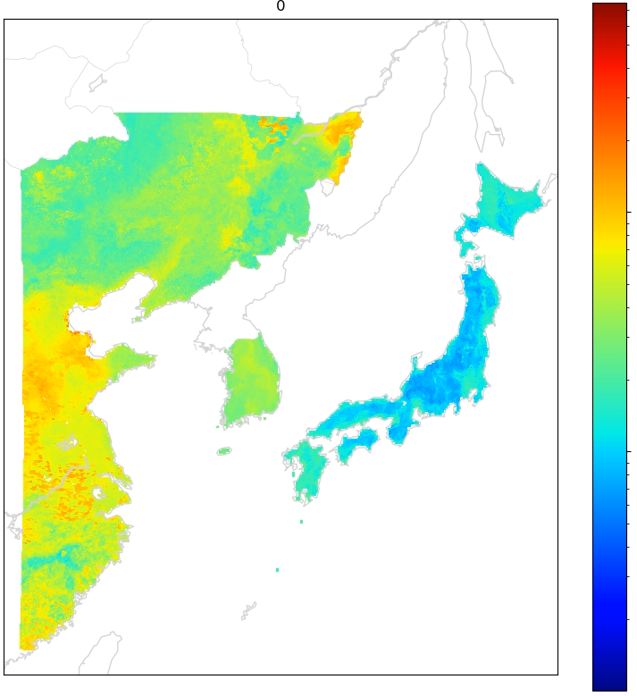
V2 workflow for continuous PM_{2.5} from AOD
1. Gapfill AOD
2. PM₁₀ → PM_{2.5}
3. Estimate PM_{2.5} for domain
Daily PM_{2.5} from March 2011
500
Filled AOD
300
3
200
100
2
50
30
PM_{2.5} (µg m⁻³)
20
10
1
5
3
AOD for inferring PM_{2.5}
2
0

Slide 9
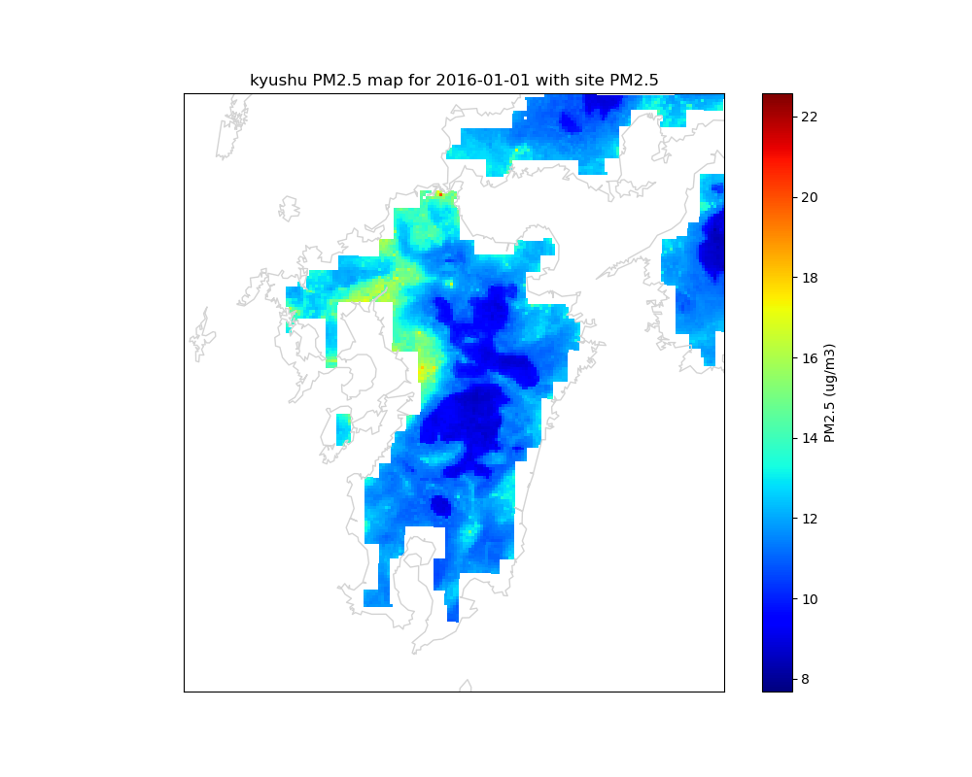
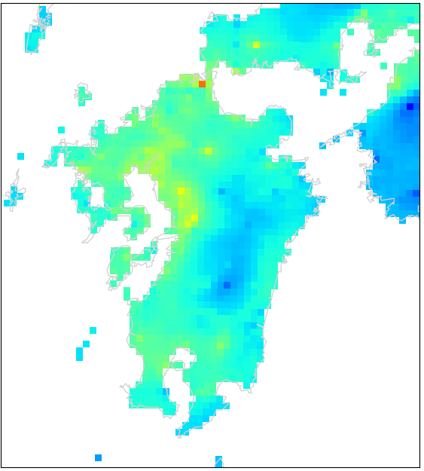
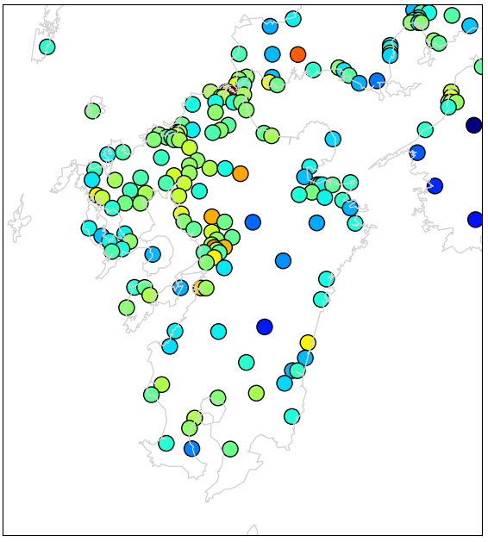
Improved extrapolation into clean rural/mountainous regions (Kyushu case study)
2016 annual mean, Kyushu
22
20
18
16
Mountains
14
Coastal data missing due to ERALand; fixing now
12
10
GOCI PM_{2.5} v1
NIES sites
GOCI PM_{2.5} v2
8
Notes:
Why this improvement? Better data, algorithm forced to perform better in rural areas by strongly increasing penalty. Not quite an apples-to-apples comparison, slightly different averaging periods.
Forcing better rural representation degrades representation in urban areas because only so much the cost function can do
Data ~10km from coasts missing due to higher-res reanalysis replay over land only (working on bug fix)

Slide 10
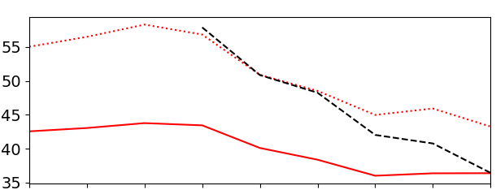
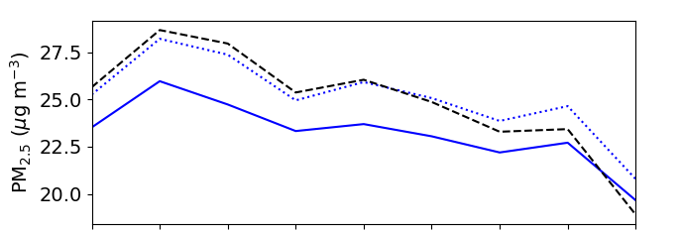
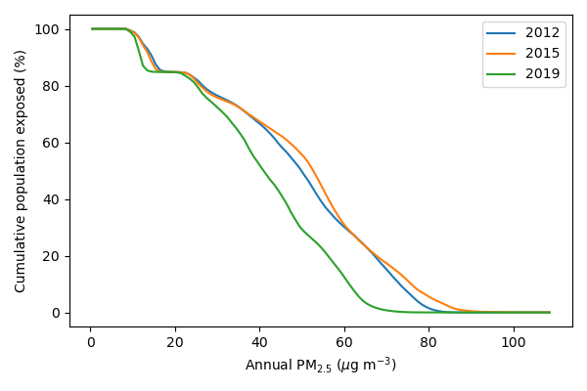
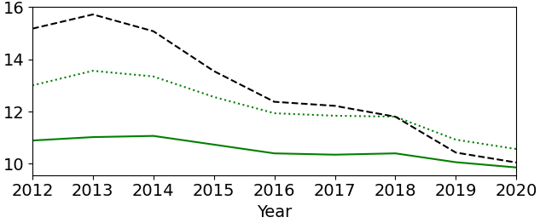
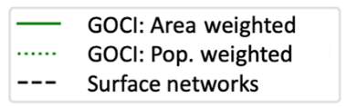
Dramatic improvements in PM_{2.5} across three countries in study period
National annual mean trends
Eastern China
Annual PM_{2.5} population exposures
South Korea
Japan
Notes:
In 2015, 55% of population in study domain are exposed to annual PM2.5 above the 50 ug/m3 level in 2015. This is down to 29% by 2019, with most improvement seen in China.

Slide 11
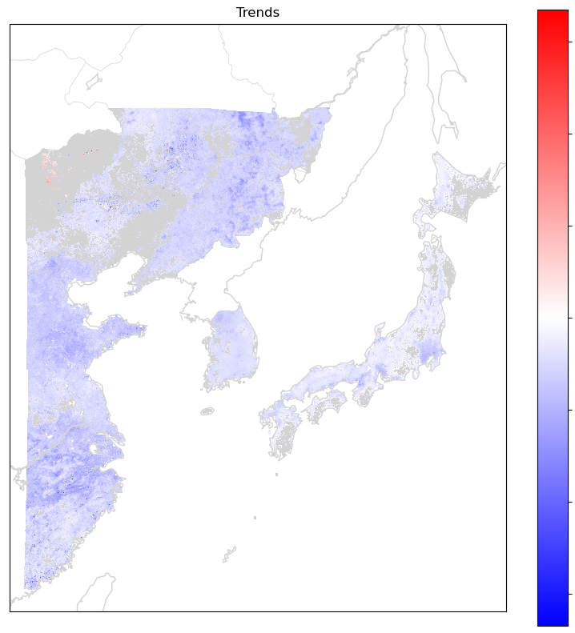
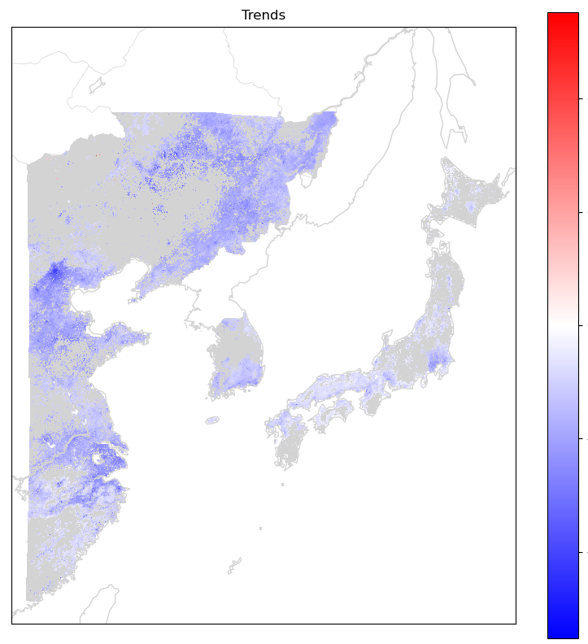

Rapid but uneven improvements in PM_{2.5} across East Asia
2012-20, annual trend
15
2015-20, annual trend
10
10
5
5
$$Δ{PM}_{2.5} a^{−1} (\%)$$
0
0
-5
-5
no recent trend in SMA; many rural areas
-10
-10
(relative to 2015)
-15
(relative to 2015)

Slide 12
Conclusions
GOCI PM_{2.5} v2.0 algorithm offers daily 24-h mean PM_{2.5} at 2km resolution from 2011-2020 for eastern China, South Korea, and Japan.
  Sharper separation of neighborhood-level pollution: ready for public health applications. Data will be free and publicly available online soon!
  Improved representation of clean areas relative to v1.0
PM_{2.5} concentrations predicted by the RF algorithm demonstrate dramatic improvements in pollution that slow by end of decade especially in rural areas
Improved dataset along with analysis of drivers will be released with paper soon – contact pendergrass@g.harvard.edu if interested.

